Slide 1

Chapter 9 Design Concepts
keyword
Data Design Architectural Design Interface Design Component-level Design
Deployment-level Design
Firmness Commodity Delight
Functionality Usability Reliability Performance Supportability
Refactoring Modularity
Cohesion Coupling
Polymorphism
© 2010 Sichuan University All rights reserved. | Confidential

Slide 2
Chapter 9 Design Concepts
Content
Design within the context of software engineering
Design Process and Design Quality
Design Concepts
Design Model
Data Design Elements
Architectural Design Elements
Interface Design Elements
Component-level Design Elements
Deployment-level Design Elements
© 2010 Sichuan University All rights reserved. | Confidential

Slide 3
Requirement Analysis & Design
What: Requirement Analysis
How: Design
© 2010 Sichuan University All rights reserved. | Confidential

Slide 4
Design
Mitch Kapor, the creator of Lotus 1-2-3, presented a “software design manifesto” in Dr. Dobbs Journal. He said:
Good software design should exhibit:
Firmness: A program should not have any bugs that inhibit its function. (坚固)可靠
Commodity: A program should be suitable for the purposes for which it was intended.（适用）实现所有用户需求功能
Delight: The experience of using the program should be pleasurable one.（愉悦）良好的用户体验
The goal of design is to produce a model or representation that exhibits firmness, commodity, and delight
设计出坚固-适用-愉悦的模型
© 2010 Sichuan University All rights reserved. | Confidential

Slide 5
The View of Design
技术观点
过程设计
结构设计
数据设计
概要设计
管理角度
详细设计

Slide 6
Software Design （定义）
软件设计：包括数据设计、架构设计、接口设计和构件设计。
软件设计是软件工程中一个非常重要的阶段，处于技术核心(它是建模活动的最后一个软件工程活动)，它依据需求建模完成设计，并为编码（构造）提供技术规范和设计指导。
软件设计是一个迭代的过程，概要设计到详细设计
© 2010 Sichuan University All rights reserved. | Confidential

Slide 7
Software Design（参考）
Encompasses the set of principles, concepts, and practices that lead to the development of a high quality system or product
Design principles establish and overriding philosophy that guides the designer as the work is performed
Design concepts must be understood before the mechanics of design practice are applied
Software design practices change continuously as new methods, better analysis, and broader understanding evolve
.
These slides are designed to accompany Software Engineering: A Practitioner’s Approach, 8/e (McGraw-Hill, 2014) Slides copyright 2014 by Roger Pressman.

Slide 8
Software Engineering Design
Data/Class design – transforms analysis classes into implementation classes and data structures
Architectural design – defines relationships among the major software structural elements
Interface design – defines how software elements, hardware elements, and end-users communicate
Component-level design – transforms structural elements into procedural descriptions of software components
These slides are designed to accompany Software Engineering: A Practitioner’s Approach, 8/e (McGraw-Hill, 2014) Slides copyright 2014 by Roger Pressman.

Slide 9
Analysis Model -> Design Model
没有基于数据建模元素？
© 2010 Sichuan University All rights reserved. | Confidential

Slide 10
Analysis Model -> Design Model （第8版）

Slide 11
9.1 a. The data/class design
The data/class design transforms class models into design class realizations and the requisite data structures required to implement the software. (class diagrams, analysis packages, CRC models, Collaboration diagrams). (data/class design)主要从数据和类的需求建模中导出设计
Part of class design may occur in conjunction with the design of software architecture. (architectural design) 与架构设计协同完成类的设计
More detailed class design occurs as each software component is designed. (component level design)
© 2010 Sichuan University All rights reserved. | Confidential

Slide 12
9.1 b. The architectural design
The architectural design defines the relationship between major structural elements of the software, the architectural styles and design patterns that can be used to achieve the requirements defined for the system, and the constraints that affect the way in which architecture can be implemented. The architectural design representation- the framework of a computer-based system- is derived from the requirements model.
也可以从很多设计模式中导出
(e.g. B/S C/S embedded-sys)
© 2010 Sichuan University All rights reserved. | Confidential

Slide 13
9.1 c. The interface design
The interface design describes how the software communicates with systems that interoperate with it , and with humans who use it. An interface implies a flow of information (e.g., data and /or control) and a specific type of behavior. Therefore, usage scenarios and behavioral models provide much of the information required for interface design
（数据流、行为、场景的模型-元素，作为接口设计的基础）
© 2010 Sichuan University All rights reserved. | Confidential

Slide 14
9.1 d. The component-level design
The component-level design transforms structural elements of the software architecture into a procedural description of software components.
Information obtained from the class-based models, flow models, and behavioral models serve as the basis for component design.
© 2010 Sichuan University All rights reserved. | Confidential

Slide 15
9.2 The Design Process
Software design is an iterative process through which requirement are translated into a “blueprint” for constructing the software.
Initially, The design is represented a high level of abstraction -a level that can be directly traced to the specific system objective and and more detailed data, functional, and behavioral requirements
As design iterative occur, subsequent refinement leads to design representations at much lower levels of abstraction
© 2010 Sichuan University All rights reserved. | Confidential

Slide 16
9.2.1 A guide for the evaluation of a good design
指导良好设计评价的3个特征：
the design must implement all of the explicit requirements contained in the analysis model, and it must accommodate all of the implicit requirements desired by the customer.（实现所有明确需求和隐含需求）
the design must be a readable, understandable guide for those who generate code and for those who test and subsequently support the software.（易读、易懂，容易生成代码。详细设计）
the design should provide a complete picture of the software, addressing the data, functional, and behavioral domains from an implementation perspective.（应提供软件的全貌，从实现的角度说明:数据、功能和行为域。概要设计）
© 2010 Sichuan University All rights reserved. | Confidential

Slide 17
Quality Guidelines 质量指导原则
A design should exhibit an architecture (a) created using recognizable architectural styles or patterns, (b) composed of well designed components (c) implemented in an evolutionary fashion.
A design should be modular.
A design should contain distinct representations of data, architecture, interfaces, and components.（设计表示清晰）
A design should lead to data structures that are drawn from recognizable data patterns.
A design should contain functionally independent components.
A design should lead to interfaces that reduce the complexity of connections between components and the external environment.
A design should be derived using a repeatable method that is driven by software requirements analysis.
A design should be represented using meaningful notation.

Slide 18
软件质量属性Quality attributes-FURPS （重点掌握）
Functionality 功能性
Usability 易用性
Reliability 可靠性
Performance-高性能processing speed/response time/
resource consumption/throughput/efficiency
Supportability- 可支持性（可维护、可测试、兼容、可配置、简易性等）
maintainability/testability/compatibility/
Configurability-the ability to organize and control elements of the software configuration
Convenient Installation
Locate problems easily
Proposed by HP, short for FURPS
FURPS quality attributes represent a target for all software design
并不是每个软件质量属性都具有相同的权重，有的应用强调功能性，特别突出安全性；有的可能要求性能，特别突出处理速度；有的强调可靠性。
必须在设计开始时就考虑这些质量属性，而不是在设计完成后和构造开始时才考虑
© 2010 Sichuan University All rights reserved. | Confidential

Slide 19
9.2.2 the evolution of software design
© 2010 Sichuan University All rights reserved. | Confidential

Slide 20
Common Design Characteristics（参考）
Each new software design methodology introduces unique heuristics and notions – yet they each contain:
A mechanism for the translating the requirements model into a design representation.需求模型-》设计模型
A notation for representing functional components and their interfaces.表示功能性构件及它们之间的接口
Heuristics for refinement and partitioning.精化和分割的启发式方法
Guidelines for quality assessment.质量评估的指导原则

Slide 21
9.3 Fundamental Concepts
Abstraction—data, procedure
Architecture—the overall structure of the software
Patterns—”conveys the essence” of a proven design solution
Separation of concerns—any complex problem can be more easily handled if it is subdivided into pieces
Modularity—compartmentalization of data and function
Hiding—controlled interfaces
Functional independence—single-minded function and low coupling
Refinement—elaboration of detail for all abstractions
Refactoring—a reorganization technique that simplifies the design
OO design concepts—Appendix II
Design Classes—provide design detail that will enable analysis classes to be implemented
© 2010 Sichuan University All rights reserved. | Confidential

Slide 22
9.3.1 Abstraction
抽象就是从众多的事物中抽取出共同的、本质性的特征，而舍弃其非本质的特征
抽象有多个层级，在最高的抽象级上，可以以概括性的术语描述，在较低级别上，提供更详细的描述
© 2010 Sichuan University All rights reserved. | Confidential

Slide 23
9.3.1 Abstraction
Data Abstraction
Procedural Abstraction
数据抽象：是描述数据对象的数据集合，包含一组描述此数据对象的属性。
过程抽象：是指具有明确和有限功能的指令序列，表明了过程的功能；
© 2010 Sichuan University All rights reserved. | Confidential

Slide 24
9.3.1 Data Abstraction
door
manufacturer
model number
type
swing direction
inserts
lights
type
number
weight
opening mechanism
implemented as a data structure
© 2010 Sichuan University All rights reserved. | Confidential

Slide 25
Procedural Abstraction
open
details of enter
algorithm
implemented with a "knowledge" of the
object that is associated with enter
© 2010 Sichuan University All rights reserved. | Confidential

Slide 26
9.3.2 Architecture
软件体系结构是指软件的整体结构和这种结构为系统提供概念完整性的方式。
简单来说，它是程序构件（模块）的结构或组织、这些构件交互的形式以及这些构件所用数据的结构
Derive an architectural rendering of a system
(系统结构图)
软件设计的目标之一就是导出系统的体系结构图，指导更详细的进一步设计活动
© 2010 Sichuan University All rights reserved. | Confidential

Slide 27
9.3.2 Architecture Properties 体系结构设计属性：
Structural properties. 结构特性
This aspect of the architectural design representation defines the components of a system (e.g., modules, objects, filters) and the manner in which those components are packaged and interact with one another.软件结构设计定义了构件被封装的方式，以及构件之间相互作用的方式
For example, objects are packaged to encapsulate both data and the processing that manipulates the data and interact via the invocation of methods
Extra-functional properties. 外部功能特性
The architectural design description should address how the design architecture achieves requirements for performance, capacity, reliability, security, adaptability, and other system characteristics.
Families of related systems. 相关系统（与设计系统相似的系统，复用）
The architectural design should draw upon repeatable patterns that are commonly encountered in the design of families of similar systems. In essence, the design should have the ability to reuse architectural building blocks.
© 2010 Sichuan University All rights reserved. | Confidential

Slide 28
9.3.3 Patterns
提供（已证明适用的）某个特定问题的解决方案
Design Pattern Template
Pattern name—describes the essence of the pattern in a short but expressive name
Intent—describes the pattern and what it does
Also-known-as—lists any synonyms for the pattern
Motivation—provides an example of the problem
Applicability—notes specific design situations in which the pattern is applicable
Structure—describes the classes that are required to implement the pattern
Participants—describes the responsibilities of the classes that are required to implement the pattern
Collaborations—describes how the participants collaborate to carry out their responsibilities
Consequences—describes the “design forces” that affect the pattern and the potential trade-offs that must be considered when the pattern is implemented
Related patterns—cross-references related design patterns
© 2010 Sichuan University All rights reserved. | Confidential

Slide 29
9.3.4 Separation of Concerns
Definition：
Any complex problem can be more easily handled if it is subdivided into pieces that can each be solved and/or optimized independently
A concern is a feature or behavior that is specified as part of the requirements model for the software
By separating concerns into smaller, and therefore more manageable pieces, a problem takes less effort and time to solve.
“关注点分离”在其它相关设计概念，如：模块化、功能独立、求精等也有体现。
© 2010 Sichuan University All rights reserved. | Confidential

Slide 30
9.3.5 Modularity
Modularity is the most common manifestation of separation of concerns 模块化是关注点分离最常见的表现
模块是软件被划分为独立命名的，可处理的构件；模块化就是其尽可能相对独立完成单一功能，做到高内聚、低耦合。同时，模块的划分要适度，模块数量也不是划分越多就好。
© 2010 Sichuan University All rights reserved. | Confidential

Slide 31
9.3.5 Modularity
Why Modularity?
–easier to build, easier to change, easier to fix
"modularity is the single attribute of software that allows a program to be intellectually manageable" [Mye78].
Monolithic software (i.e., a large program composed of a single module) cannot be easily grasped by a software engineer.
The number of control paths, span of reference, number of variables, and overall complexity would make understanding close to impossible.
In almost all instances, you should break the design into many modules, hoping to make understanding easier and as a consequence, reduce the cost required to build the software.
© 2010 Sichuan University All rights reserved. | Confidential

Slide 32
Sizing Modules: Two Views
Cohesion & coupling
© 2010 Sichuan University All rights reserved. | Confidential

Slide 33
Modularity: Trade-offs（权衡 ）
What is the "right" number of modules
for a specific software design?
module development cost
cost of
software
module
integration
cost
optimal number
number of modules
of modules
参看Figure modularity and software cost
© 2010 Sichuan University All rights reserved. | Confidential

Slide 34
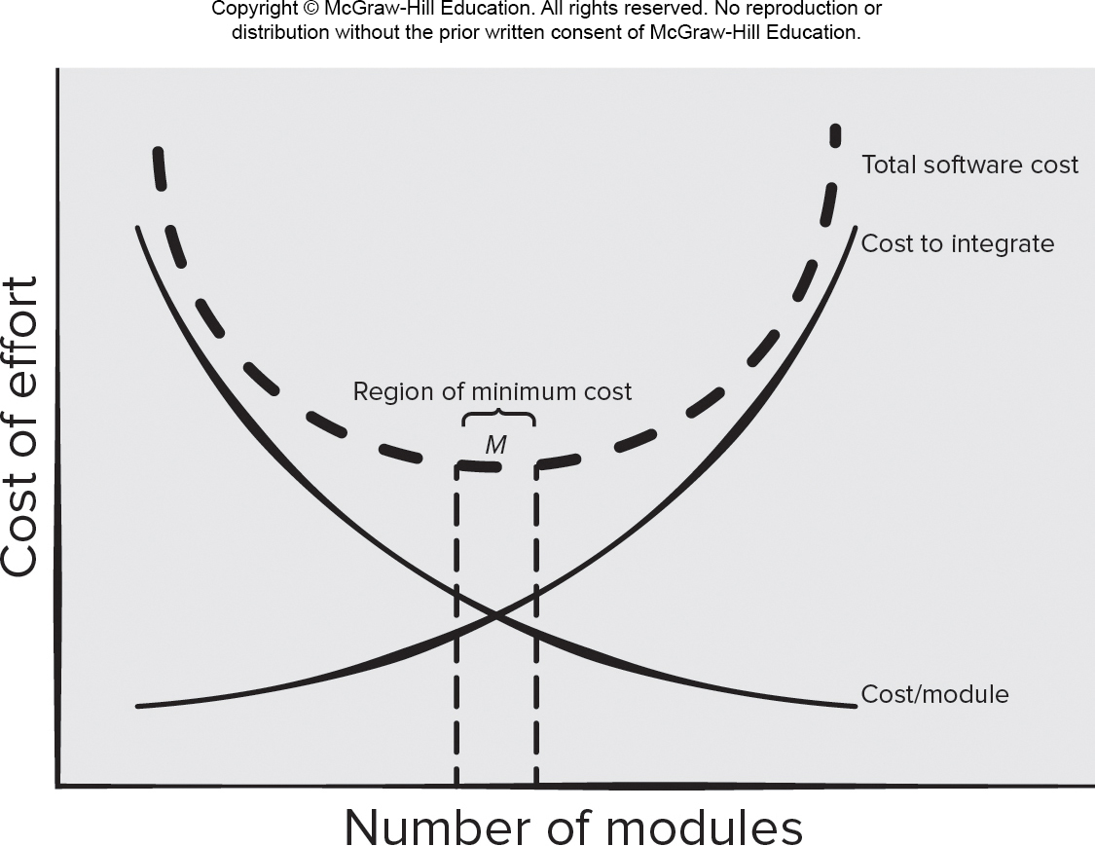
Modularity and Software Cost
Access the text alternative for slide images.

Slide 35
9.3.6 Information Hiding
module
• algorithm
controlled
interface
• data structure
• details of external interface
• resource allocation policy
clients
"secret"
a specific design decision
© 2010 Sichuan University All rights reserved. | Confidential

Slide 36
Information Hiding
信息隐蔽原则：
每个模块对其它所有模块都隐蔽自己的设计决策。即：在本模块中包含的信息（算法和数据）不要被（不需要这些信息的）其它模块访问（影响）。
封装
尽量少的全局变量
controlled interfaces which define and enforces access to component procedural detail and any local data structure used by the component.
© 2010 Sichuan University All rights reserved. | Confidential

Slide 37
Why Information Hiding?（重要）
reduces the likelihood of “side effects”（减少副作用、不良反应的可能性）
limits the global impact of local design decisions
emphasizes communication through controlled interfaces
discourages the use of global data
leads to encapsulation —an attribute of high quality design
results in higher quality software
© 2010 Sichuan University All rights reserved. | Confidential

Slide 38
9.3.7 Functional Independence
The concept of functional independence is a direct outgrowth of separation of concerns, modularity, and the concepts of abstraction and information hiding 功能独立的概念是关注点分离、模块化、抽象和信息隐蔽概念的直接产物
achieved by developing modules with “single-minded” function(单一功能) and an “aversion” to excessive interaction with other modules.（避免与其他模块过多的交互）
Independence is assessed using two qualitative criteria：Cohesion AND Coupling
内聚显示模块相关功能的强度，一个内聚的模块应该只完成一件工作
耦合表示多个模块之间的相互联系（的强度）。应当尽力将模块间耦合度降到最低。
© 2010 Sichuan University All rights reserved. | Confidential

Slide 39
Functional Independence
Cohesion is an indication of the relative functional strength of a module.(显示某个模块相关功能的强度)
A cohesive module performs a single task, requiring little interaction with other components in other parts of a program. Stated simply, a cohesive module should (ideally) do just one thing.
Coupling is an indication of the relative interdependence among modules.（显示模块间相互依赖性）
Coupling depends on the interface complexity between modules, the point at which entry or reference is made to a module, and what data pass across the interface.
© 2010 Sichuan University All rights reserved. | Confidential

Slide 40
Cohesion & Coupling
补充内容
全局变量，局部变量
形参与实参
公有与私有变量
Goto 语句
递归调用与退出，堆栈
。。。
© 2010 Sichuan University All rights reserved. | Confidential

Slide 41
Coupling（参考）
Coupling is a measure of interconnection among modules in a software structure. (Yourdon & Constantine,1978)

Slide 42
The Types of Coupling （参考）
Great deal of dependence
Independent
☹ Highly coupled
Loosely coupled
Uncoupled ☺

Slide 43
Content Coupling (1) （参考）
♦ 内容耦合(Content Coupling): One module modifies another.
……
例1：A访问C的内部数据或不通过正常入口而转入C的内部。
A
B
A:
…………
…………
goto C1
…………
…………
C
D
C:
…………
…………
C1:
……
……

Slide 44
Content Coupling (2) （参考）
A
例2：部分代码重叠（常出现在汇编程序中）
B
例3：一个模块有多个入口（功能）
A:
………………
………………
entry 1:
………………
………………
entry 2:
………………
………………
☹ The least desirable

Slide 45
Common Coupling （参考）
♦ 公共耦合 (Common coupling)：Data are accessible from a common data store.
Global : V1
V2
Global : V1
V2
A:
…………
…………
A1=V1+V2
…………
…………
B:
…………
…………
V1=B1
…………
…………
A:
…………
…………
V1++
…………
…………
B:
…………
…………
V2=B1+V1
…………
…………
问题：♣ 公共部分的改动将影响所有调用它的模块；
♣ 公共部分的数据存取无法控制；
♣ 复杂程度随耦合模块的个数增加而增加。

Slide 46
Control Coupling and Data Coupling （参考）
♦控制耦合(Control coupling)：One module passes parameters to control the activity of another module.
B
Fn
接口单一，但仍然影响被控模块的内部逻辑。
Flag
……
A
Flag
F2
……
F1
♦ 数据耦合(Data coupling): Only data are passed. It is easy to trace data and make changes.
☺ The most desirable.
原则：尽量使用数据耦合，少用控制耦合，限制公共耦合的范围，完全不用内容耦合。

Slide 47
Cohesion （参考）
内聚 (Cohesion): The elements of a module are directed to perform the same task.
Goal: as cohesive as possible.

Slide 48
The Types of Cohesion (1) （参考）
1. 低内聚：
♦巧合内聚（Coincidental cohesion）：Unrelated functions, processes, or data are found in the same module (for convenience).
♦ 逻辑内聚（Logical cohesion）：Logically related functions or data are placed in the same module.
Example：
from disk
A:
Read inputs
from tape
from ……

Slide 49
The Types of Cohesion (2) （参考）
♦ 时间内聚（Temporal cohesion）：The functions are related only by the timing involved.
例如：系统的初始化
问题：不同功能混在一个模块中，有时共用部分编码，使局部功能的修改牵动全局。
2. 中内聚：
♦ 过程内聚（Procedural cohesion）：Functions are grouped together in a module to ensure a certain order of performance.
例如：
enter data
check data
manipulate data

Slide 50
The Types of Cohesion (3) （参考）
♦ 通信内聚（Communicational cohesion）：All the functions in a module operate on or produce the same data set.
例1：从同一磁带上读取不相干的数据 —— 可能破坏独立性。
例2：

Slide 51
The Types of Cohesion (4) （参考）
3. 高内聚：
♦ 顺序内聚（Sequential cohesion）：The output from one part of a module is the input to the next part.
♦ 功能内聚（Functional cohesion）：Every processing element is essential to the performance of a single function.

Slide 52
9.3.8 Stepwise Refinement 逐步求精
Stepwise refinement is a top-down design strategy. A program is developed by successively refining levels of procedural detail.逐步求精是一种自顶向下的设计策略。通过连续精化过程细节层次来实现程序开发。
Refinement is actually a process of elaboration
© 2010 Sichuan University All rights reserved. | Confidential

Slide 53
9.3.8 Stepwise Refinement 逐步求精
Abstraction and refinement are complementary concepts. Abstraction enables you to specify procedure and data internally but suppress the need for “outsiders” to have knowledge of low-level details. Refinement helps you to reveal low-level detail as design progresses. Both concepts allow you to create a complete design model as the design evolves。
抽象和精化是互补的概念。抽象能够明确说明内部过程和数据，但对“外部使用者”隐藏了底层细节；精化有助于在设计过程中揭示底层细节，实际上就是一个细化的过程。
补充：
抽象就是从众多的事物中抽取出共同的、本质性的特征，而舍弃其非本质的特征 （数据抽象、过程抽象）。抽象有多个层级，在最高的抽象级上，可以以概括性的术语描述，在较低级别上，提供更详细的描述
© 2010 Sichuan University All rights reserved. | Confidential

Slide 54
9.3.8 Stepwise Refinement
open
walk to door;
reach for knob;
open door;
repeat until door opens
turn knob clockwise;
walk through;
if knob doesn't turn, then
close door.
take key out;
find correct key;
insert in lock;
endif
pull/push door
move out of way;
end repeat
© 2010 Sichuan University All rights reserved. | Confidential

Slide 55
9.3.9 Refactoring
重构就是仅修改软件（模块）内部结构，而不改变其外部行为（接口属性）
Refactoring is the process of changing a software system in such a way that it does not alter the external behavior of the code [design] yet improves its internal structure.”
© 2010 Sichuan University All rights reserved. | Confidential

Slide 56
9.3.9 Refactoring
When software is refactored, the existing design is examined for
Redundancy（冗余）
unused design elements
inefficient or unnecessary algorithms
poorly constructed or inappropriate data structures or any other design failure that can be corrected to yield a better design.
XP Design的重要概念
© 2010 Sichuan University All rights reserved. | Confidential

Slide 57
9.3.10 OO Design Concepts
（面向对象 Object-Oriented）
Class
Object
Inheritance 继承—all responsibilities of a superclass is immediately inherited by all subclasses
Messages 消息—stimulate some behavior to occur in the receiving object（对象之间的相互作用）
Polymorphism 多态— 多态性是指相同的操作或函数、过程可作用于多种类型的对象上并获得不同的结果。不同的对象，收到同一操作（消息）可以产生不同的结果，这种现象称为多态性。
© 2010 Sichuan University All rights reserved. | Confidential

Slide 58
Messages
© 2010 Sichuan University All rights reserved. | Confidential

Slide 59
Polymorphism多态
多态性是指相同的操作或函数、过程可作用于多种类型的对象上并获得不同的结果。不同的对象，收到同一操作（消息）可以产生不同的结果，这种现象称为多态性。
多态是面向对象设计的重要特征
如：+，-等操作
© 2010 Sichuan University All rights reserved. | Confidential

Slide 60
Polymorphism
Conventional approach …
case of graphtype:
if graphtype = linegraph then DrawLineGraph (data);
if graphtype = piechart then DrawPieChart (data);
if graphtype = histogram then DrawHisto (data);
if graphtype = kiviat then DrawKiviat (data);
end case;
All of the graphs become subclasses of a general class called graph. Using a concept called overloading [TAY90], each subclass defines an operation called draw. An object can send a draw message to any one of the objects instantiated from any one of the subclasses. The object receiving the message will invoke its own draw operation to create the appropriate graph.
graphtype draw
graph
graphtype draw()
linegraph
piechart
histogram
kiviat
graphtype draw()
graphtype draw()
graphtype draw()
graphtype draw()
© 2010 Sichuan University All rights reserved. | Confidential

Slide 61
9.3.10 Design Classes
Review：Analysis classes （边界类-实体类-控制类）
分析类抽象程度较高
Design classes：相对（分析类）而言，表现类的技术细节
User interface classes-用户接口类
Business domain classes-业务域类
Process classes-过程类（底层业务抽象）
Persistent classes-持久类（数据存储）
System classes-系统类（管理与控制）
随着体系结构的形成，每个分析类转化为设计表示，抽象程度就降低了。也就是说，分析类使用业务域的专用术语，而设计类更多的表示技术细节，更专业化，用于指导编程
© 2010 Sichuan University All rights reserved. | Confidential

Slide 62
9.3.10 Design Classes
需求模型定义：分析类，分析类抽象程度较高。
Analysis classes （边界类-实体类-控制类）
设计模型定义：设计类Design Classes相对（分析类）而言，表现类的技术细节，抽象程度降低。通过提供设计细节精化分析类，这些设计细节促成类的具体细节实现。
Design classes：（建议分类）
User interface classes-用户接口类
Business domain classes-业务域类
Process classes-过程类（底层业务抽象）
Persistent classes-持久类（数据存储）
System classes-系统类（管理与控制）
© 2010 Sichuan University All rights reserved. | Confidential

Slide 63
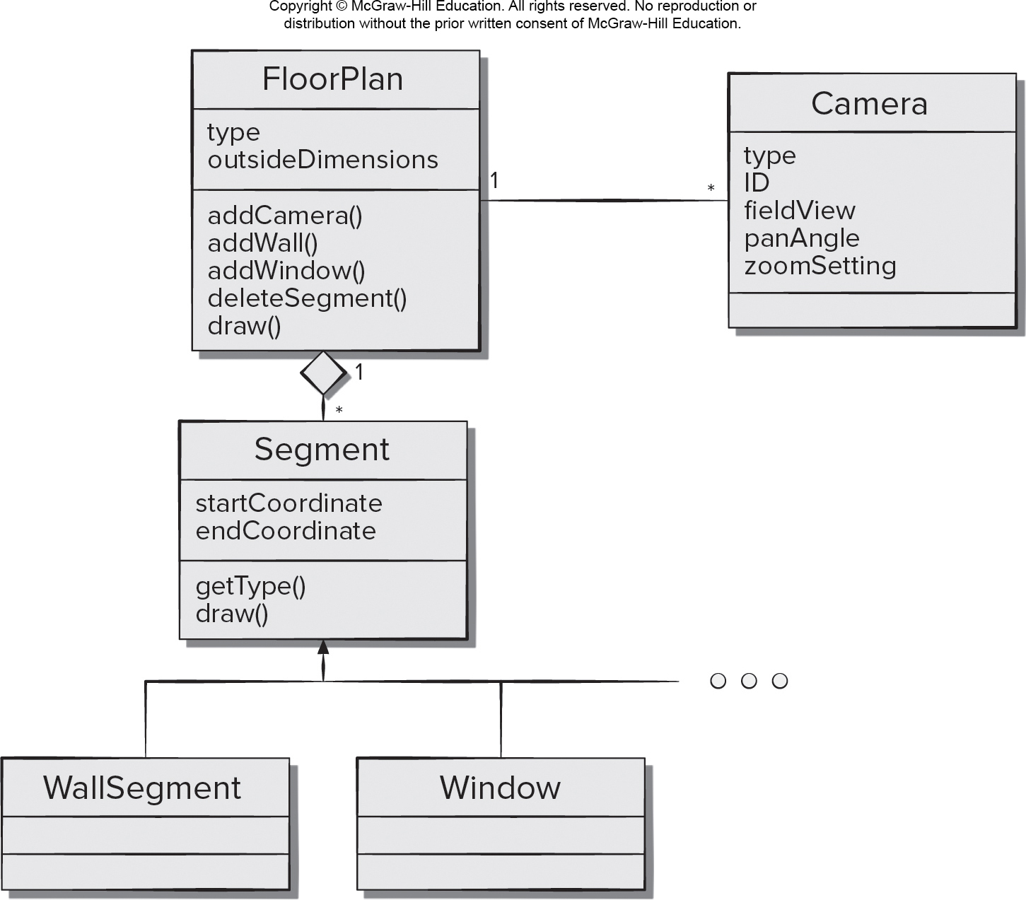
Design Class Example
Access the text alternative for slide images.

Slide 64
Design Class Characteristics
良好的（设计）类4个特征
Complete - includes all necessary attributes and methods) and sufficient (contains only those methods needed to achieve class intent).(完整性与充分性)
Primitiveness – each class method focuses on providing one service.（原始性）唯一性
High cohesion – small, focused, single-minded classes.（高类聚）
Low coupling – class collaboration kept to minimum.（低耦合）

Slide 65
9.4 The Design Model
在某些情况下，分析模型和设计模式之间存在明显区别，而另一些情况下，分析模型慢慢地融入设计模型没有明显区别
© 2010 Sichuan University All rights reserved. | Confidential

Slide 66
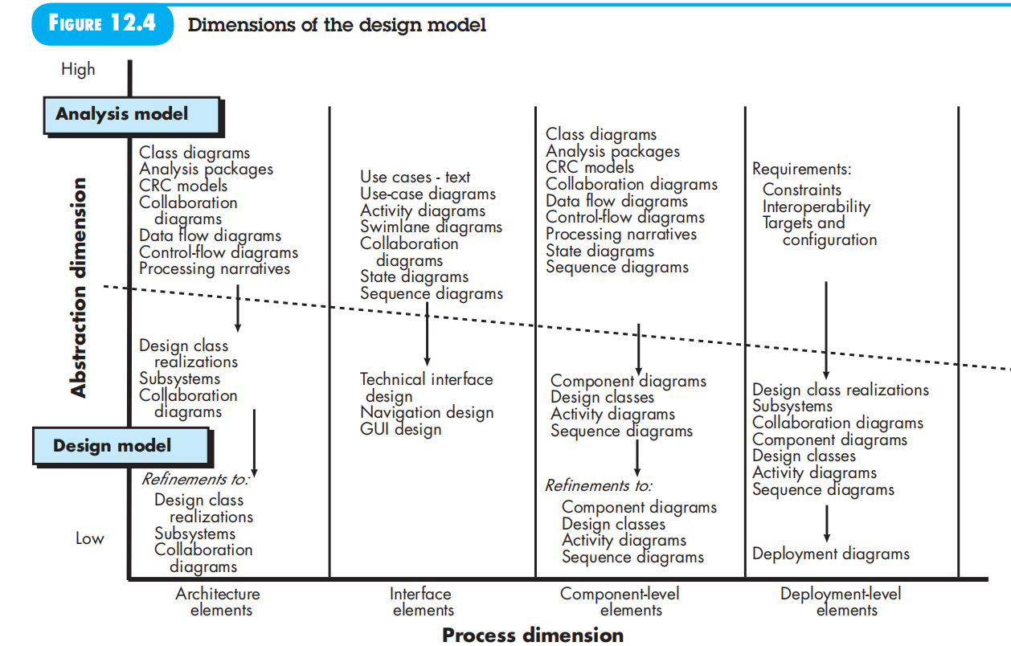
9.4 The Design Model
© 2010 Sichuan University All rights reserved. | Confidential

Slide 67
Design Model
Referring to Figure 9.4, the dashed line indicates the boundary between the analysis and design models. In some cases, a clear distinction between the analysis and design models is possible. In other cases, the analysis model slowly blends into the design and a clear distinction is less obvious.
Model elements indicated along the horizontal axis are not always developed in a sequential fashion. In most cases preliminary architectural design sets the stage and is followed by interface design and component-level design, which often occur in parallel. The deployment model is usually delayed until the design has been fully developed
过程维度表示设计模型的演化，设计任务作为软件过程的一部分被执行；(软件设计过程并不总是串行的，有些是并行的，比如接口和构件设计)
抽象维度表示详细级别，分析模型的每个元素转化为一个等价的设计，然后迭代求精
© 2010 Sichuan University All rights reserved. | Confidential

Slide 68
9.4.1 Design Modeling Principles
Principle #1. Design should be traceable to the requirements model.
Principle #2. Always consider the architecture of the system to be built.
Principle #3. Design of data is as important as design of processing functions.
Principle #4. Interfaces (both internal and external) must be designed with care.
Principle #5. User interface design should be tuned to the needs of the end-user and stress ease of use.

Slide 69
9.4.1 Design Modeling Principles
Principle #6. Component-level design should be functionally independent.
Principle #7. Components should be loosely coupled to each other than the environment.
Principle #8. Design representations (models) should be easily understandable.
Principle #9. The design should be developed iteratively.
Principle #10. Creation of a design model does not preclude using an agile approach.

Slide 70
Design Model Elements
Data design elements 9.4.1
Data model --> data structures
Data model --> database architecture
Architectural design elements derived from 9.4.2
Application domain
Analysis classes, their relationships, collaborations and behaviors are transformed into design realizations
Patterns and “styles” (Chapter 9)
Interface design elements 9.4.3
the user interface (UI) (called usability design )
external interfaces to other systems, devices, networks or other producers or consumers of information
internal interfaces between various design components.
Component elements 9.4.4
Deployment elements 9.4.5
© 2010 Sichuan University All rights reserved. | Confidential

Slide 71
9.4.2 data design Elements
Data design creates a model of data and /or information that is represented at a high level of abstraction (the customer/user’s view of data)
数据设计：创建在高抽象级上表示的数据模型和（或）信息模型（从用户的观点） 。
之后数据模型被逐步求精为系统能够处理的表示
© 2010 Sichuan University All rights reserved. | Confidential

Slide 72
9.4.2 Data Design Elements
Data model – data objects and database architectures.
Examines data objects independently of processing.
Focuses attention on the data domain.
Creates a model at the customer’s level of abstraction.
Indicates how data objects relate to one another.
Data object can be an external entity, a thing, an event, a place, a role, an organizational unit, or a structure.
Data objects contain a set of attributes that act as an quality, characteristic, or descriptor of the object.
Data objects may be connected to one another in many different ways.

Slide 73
data design Elements
The structure of data has always been an important part of software design 数据结构是软件设计的重要部分
At the program component level, the design of data structures and the associated algorithms required to manipulate them is essential to the creation of high-quality application.
At the application level, the translation of a data model into a database is pivotal to achieving the business objectives of a system.
At the business level, the collection of information stored in disparate databases and reorganized into a “data warehouse” enables data mining or knowledge discovery that can have an impact on the success of the business itself.
In every case, data design plays an important role
© 2010 Sichuan University All rights reserved. | Confidential

Slide 74
What is Data Design?
与P70页内容基本一致
Data design ( data architecture ) creates a model of data and/or information.
It is the first step of design.
It is an important part of design.
It has a profound influence over the architecture.

Slide 75
From ERD to Database architecture
步骤：
实体集合转换成关系模式，实体集合的属性成为关系的属性，实体集合的关键字成为关系的关键字；
联系转换成关系模式，参加联系的 实体集合关键字成为关系的属性，其关键字按照联系的类型确定：
1:1联系，参加联系的任意一实体集合的关键字成为关系的关键字；
1:N联系，N的一方的实体集合的关键字成为关系的关键字；
N:M联系，参加联系的所有实体集合的关键字成为关系的关键字；

Slide 76
Example
a
d
E1
n
R
m
E2
b
e
c
关系模式：
E1 ( a, b );
E2 ( d, e );
R ( a, d, c );

Slide 77
Example
选课系统
实体Entity： 学生，老师，课程…
ER模型
学生-选课-课程（n..m）
老师-上课-课程（1..m）（有可能是多对多的关系）
字段（属性）设计
学生：ID_s，name，grade, age, department…
老师：ID_t， name，age, department …
课程：ID_c，name，introduction，…
选课：ID_s，ID_c，
上课：ID_t，ID_c，
(score,…)
( cNo., location, time,weekday…)
© 2010 Sichuan University All rights reserved. | Confidential

Slide 78
Example - discussion
选课系统
实体Entity： 学生，老师，课程…
ER模型
学生-选课-课程（n..m），老师-上课-课程（1..m）
字段（属性）设计
课程：ID_c，name，location, 时间，次数，…
选课：ID_s，ID_c，
上课：ID_t，ID_c，
！！应加入备用字段，备注字段
？？课程表与老师上课表合并？考虑多个老师上一门课（加入课程序号）
加入教室实体？？
© 2010 Sichuan University All rights reserved. | Confidential

Slide 79
9.4.3 Architectural Elements
Architectural design= the floor plan of a house
The architectural model [Sha96] is derived from three sources:
information about the application domain for the software to be built;
specific requirements model elements such as data flow diagrams or analysis classes, their relationships and collaborations for the problem at hand, and
the availability of architectural patterns and styles .
These slides are designed to accompany Software Engineering: A Practitioner’s Approach, 8/e (McGraw-Hill, 2014) Slides copyright 2014 by Roger Pressman.

Slide 80
9.4.4 Interface Elements
Interface is a set of operations that describes the externally observable behavior of a class and provides access to its public operations.
Important elements:
User interface (UI).
External interfaces to other systems.
Internal interfaces between various design components.
UI or User Experience (UX) is a major engineering action to ensure the creation on usable software products.
Internal and external interfaces should incorporate both error checking and appropriate security features.

Slide 81
9.4.4 Interface Elements
Interface design = a set of detailed drawing (and specifications) for the doors, windows and external utilities of a house)
接口设计三个重要元素：UI，外部接口，内部接口
Interface is a specifier for the externally-visible operation of a class, component, or other classifier without specification of internal structure.
Interface is a set of operations that describes some part of the behavior of a class and provides access to those operation.
Modeled using UML communication diagrams (called collaboration diagrams in UML 1.x)
© 2010 Sichuan University All rights reserved. | Confidential

Slide 82
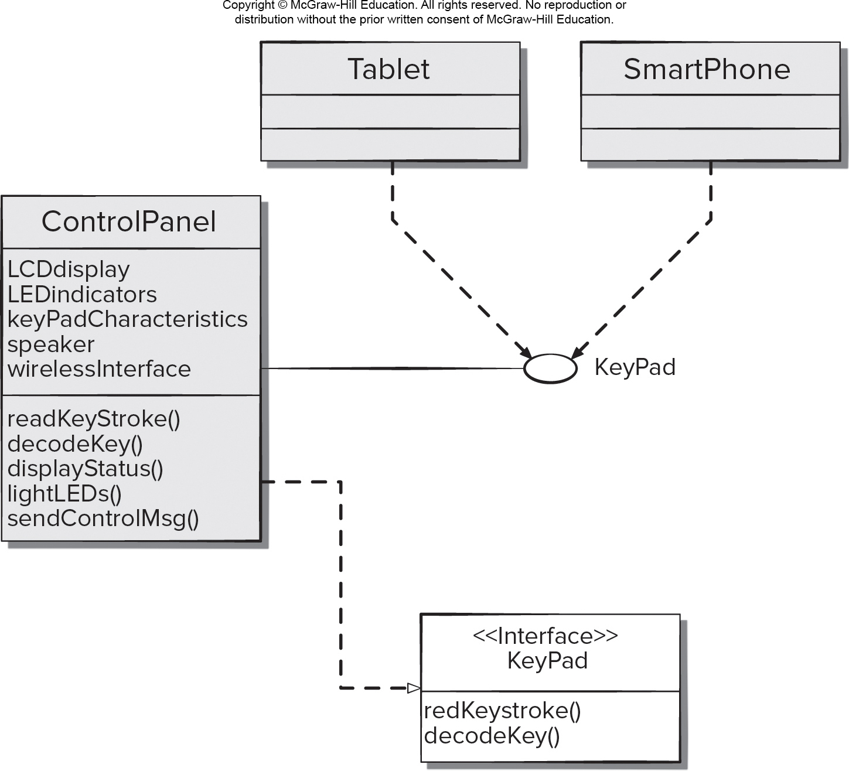
Interface Model for Control Panel
Access the text alternative for slide images.

Slide 83
Interface：ControlPanel 的接口表示
© 2010 Sichuan University All rights reserved. | Confidential

Slide 84
9.4.5 Component Elements
Describes the internal detail of each software component
Defines
Data structures for all local data objects
Algorithmic detail for all component processing functions
Interface that allows access to all component operations
Modeled using UML component diagrams, UML activity diagrams, pseudocode (PDL), and sometimes flowcharts
These slides are designed to accompany Software Engineering: A Practitioner’s Approach, 8/e (McGraw-Hill, 2014) Slides copyright 2014 by Roger Pressman.

Slide 85
9.4.5 Component Elements
Component design=a set of detailed drawing (and specifications) for each room in a house
(包括房间内布线、管道、插座、家具、装饰等)
图：表示构件和类的链接； 构件详细过程流可以使用伪代码表示
© 2010 Sichuan University All rights reserved. | Confidential

Slide 86
9.4.6 Deployment Elements
Indicates how software functionality and subsystems will be allocated within the physical computing environment指明软件功能和子系统在系统环境中的物理分布
Modeled using UML deployment diagrams
Descriptor form deployment diagrams show the computing environment but does not indicate configuration details
Instance form deployment diagrams identifying specific named hardware configurations are developed during the latter stages of design
These slides are designed to accompany Software Engineering: A Practitioner’s Approach, 8/e (McGraw-Hill, 2014) Slides copyright 2014 by Roger Pressman.

Slide 87
Deployment Diagram:
指明软件功能和子系统在系统环境中的物理分布
（如右图： CPI公司服务器，家里的控制面板和PC）
© 2010 Sichuan University All rights reserved. | Confidential

Slide 88
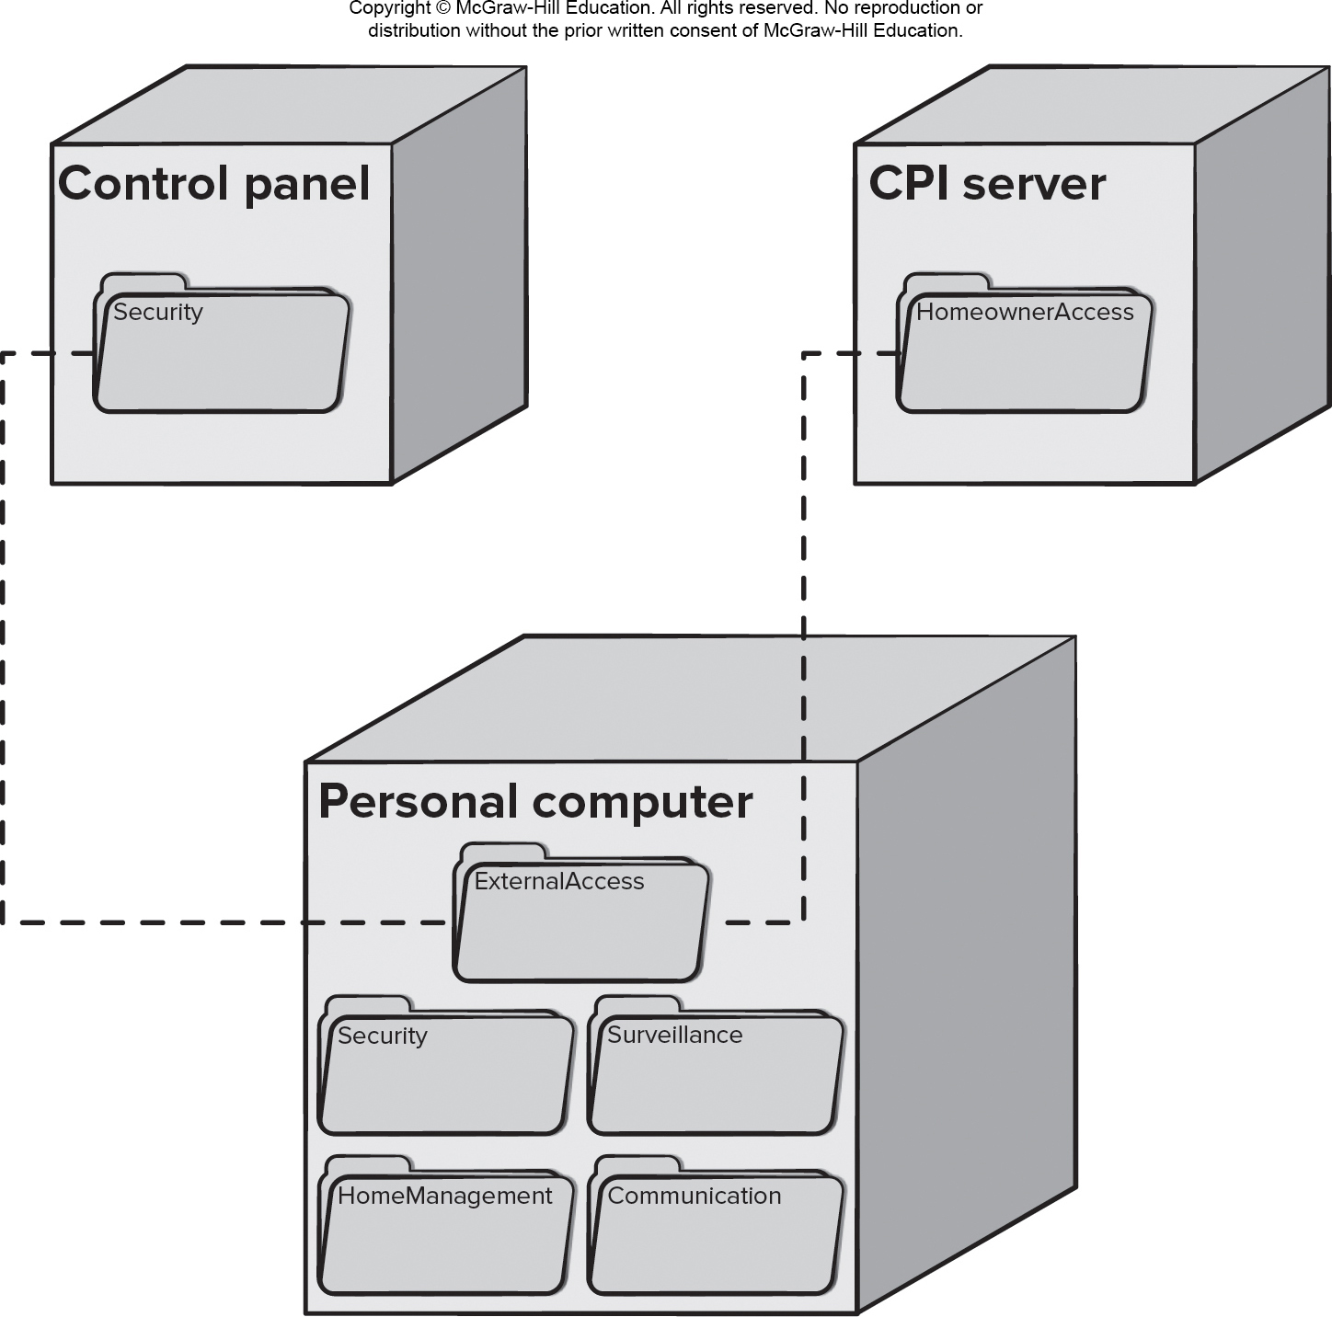
Deployment Instance Diagram
Access the text alternative for slide images.

Slide 89
Summary
The intent of software design is to apply a set of principles, concepts, and practices that lead to the development of a high-quality system.
The goal of design is to create a model of software that will implement all customer requirements correctly and bring delight to those who use it
（坚固Firmness、实用Commodity 、愉悦Delight）
Software Design includes：Data/Class Design， Architectural Design， Interface Design， Component-level Design
© 2010 Sichuan University All rights reserved. | Confidential

Slide 90
Summary
Design concepts-abstraction, architecture, patterns, separation of concerns, modularity, information hiding, functional independence, refinement, aspects, refactoring, Object-Oriented design, design classes
The design model encompasses four different elements. As each of these elements is developed, a more complete view of the design evolves
Data/class elements
architectural elements
interface design elements
component-level design elements
deployment-level design elements
© 2010 Sichuan University All rights reserved. | Confidential

Slide 91
Answer 1-e 2-e
Exercise
Which of the following are areas of concern in the design model?
architecture
data
interface
project scope
a, b and c
Which of these are characteristics of a good design?
exhibits strong coupling between its modules
implements all requirements in the analysis model
includes test cases for all components
provides a complete picture of the software
both b and d
© 2010 Sichuan University All rights reserved. | Confidential

Slide 92
Answer 3-a 4-b
Exercise
3.Information hiding makes program maintenance easier by hiding data and procedure from unaffected parts of the program.
True
False
4.Cohesion is a qualitative indication of the degree to which a module： （定性）
can be written more compactly.
focuses on just one thing.
is able to complete its function in a timely manner.
is connected to other modules and the outside world.
© 2010 Sichuan University All rights reserved. | Confidential

Slide 93
Answer 5-d 6-b
Exercise
5. Coupling is a qualitative indication of the degree to which a module
can be written more compactly.
focuses on just one thing.
is able to complete its function in a timely manner.
is connected to other modules and the outside world.
6. Polymorphism reduces the effort required to extend an object system by
coupling objects together more tightly.
enabling a number of different operations to share the same name
making objects more dependent on one another.
removing the barriers imposed by encapsulation.
© 2010 Sichuan University All rights reserved. | Confidential

Slide 94
Answer 7-c 8-a
Exercise
7. Which design model elements are used to depict a model of information represented from the user's view?
Architectural design elements
Component-level design elements
Data design elements
Interface design elements
8. Which design is analogous to the floor plan of a house?
a. Architectural design elements
b. Component-level design elements
c. Data design elements
d. Interface design elements
© 2010 Sichuan University All rights reserved. | Confidential

Slide 95
Answer 9-d 10-b
Exercise
9. Which design model is analogous to the detailed drawings of the access points and external utilities for a house?
Architectural design elements
Component-level design elements
Data design elements
Interface design elements
10. Which design model is analogous to a set of detailed drawings for each room in a house?
a. Architectural design elements
b. Component-level design elements
c. Data design elements
d. Interface design elements
© 2010 Sichuan University All rights reserved. | Confidential

Slide 96
Answer 11-b 12-a
Exercise
11. The deployment design elements specify the build order for the software components.
a. True
b. False 部署设计仅表明构件的位置而非顺序
12. One of the key problems in software reuse is the inability to find existing reusable design patterns when hundreds of candidates exist.
a. True
b. False
© 2010 Sichuan University All rights reserved. | Confidential

Slide 97
2023.10.12 作业Homework
List three characteristics that can serve as a guide to evaluate design quality.
Explain how effective modular design is achieved through functional independence of the individual modules?
Describe the principle of information hiding as it applies to software design.
What is design refactoring?
List the four design models required for a complete specification of a software design and the role of each.
© 2010 Sichuan University All rights reserved. | Confidential

Slide 98
Chapter 10 Creating An Architectural Design
Content
Software Architecture
Data Design
Architectural Styles and Patterns
Architectural Design
Assessing Alternative Architectural Design
© 2010 Sichuan University All rights reserved. | Confidential

Slide 99
Design Model Review
Date Design
Architectural Design
Interface Design
Component Design
© 2010 Sichuan University All rights reserved. | Confidential

Slide 100
Architectural Design
体系结构设计表示了建立计算机系统所需的数据结构和程序构件。它需要考虑系统采取的体系结构风格、系统组成构件的结构和性质，以及系统中所有体系结构构件之间的相互关系
Architectural design represents the structure of data and program components that are required to build a computer-based system. It considers the architectural style that the system will take, the structure and properties of the components that constitute the system, and the interrelationships that occur among all architectural components of a system.
建立设计模型数据和体系结构层的“内聚的、良好规划的表示”所需的方法
目标是提供一种导出体系结构设计的系统化方法
体系结构设计是构建软件的初始蓝图
© 2010 Sichuan University All rights reserved. | Confidential

Slide 101
10.1 Software Architecture
what is architecture
why is architecture important
architecture description
architecture decisions
© 2010 Sichuan University All rights reserved. | Confidential

Slide 102
10.1.1 What is Architecture?定义：
Software Architecture: the structure of the system, which comprise software components, the externally visible properties of those components and the relationships among them.
（体系结构是指系统的一个结构，包括软件构件，构件的属性和构件之间的相互关系）
focuses on the representation of the structure of software components, their properties, and interactions
© 2010 Sichuan University All rights reserved. | Confidential

Slide 103
Software Architecture?
Just like the plans for a house are merely a representation of the building, the software architecture representation is not an operational product, it is a representation that enables a software engineer to:
Analyze the effectiveness of the design in meeting its stated requirements,
Consider architectural alternatives at a stage when making design changes is still relatively easy, and
Reduce the risks associated with the construction of the software.

Slide 104
Architecture vs Design
在体系结构层次上，一般不会详细说明构件内部属性（如算法细节）
Design is an instance of an architecture(设计是体系结构的一个实例，类似于对象是类的实例。)
Many designs can be created based on one architecture. （对于同一个体系结构，可能会产生多个基于该体系结构的设计，如：C-S体系结构，可以用Java平台(Java EE)或者Microsoft平台（.NET框架）等多种不同的实现方法设计）
© 2010 Sichuan University All rights reserved. | Confidential

Slide 105
10.1.2 Why is Architecture Important?
Representations of software architecture are an enabler for communication between all parties (stakeholders) interested in the development of a computer-based system.-有助于各方的交流
The architecture highlights early design decisions that will have a profound impact on all software engineering work that follows and, as important, on the ultimate success of the system as an operational entity.-突出早期的设计，对其后工作很重要（打好设计的根基）
Architecture “constructs a relatively small, intellectually graspable (understandable) model of how the system is structured and how its components work together” [BAS03].-建立了一个相对小、易理解的模型，其描述了系统如何构成及构件如何一起工作
© 2010 Sichuan University All rights reserved. | Confidential

Slide 106
10.1.3 Architectural Descriptions（参考）
The I E E E Computer Society has proposed I E E E-Std-42010-2011, Systems and Software Engineering – Architecture Description.
Describes the use of architecture viewpoints, architecture frameworks, and architecture description languages as a means of codifying the conventions and common practices for architectural description.
The IEEE Standard defines an architectural description (A D) as a “a collection of products to document an architecture.”
An architecture description shall identify the system stakeholders having concerns considered fundamental to the architecture of the system-of-interest.
These concerns shall be considered when applicable and identified in the architecture description: system purpose, suitability of the architecture, feasibility of constructing and deploying the system, risks and impacts of the system, and the maintainability and evolvability of the system.

Slide 107
10.1.4 Architecture Decision（参考）
Determine information items needed for each decision.
Define links between each decision and appropriate requirements.
Provide mechanisms to change status when alternative decisions need to be evaluated.
Define prerequisite relationships among decisions to support traceability.
Link significant decisions to architectural views resulting from decisions.
Document and communicate all decisions as they are made.

Slide 108
10.2 Agility and Architecture(参考)
To avoid rework, user stories are used to create and evolve an architectural model (walking skeleton) before beginning any coding.
Use models which allow software architects to add user stories to the evolving storyboard and works with the product owner to prioritize the architectural stories as “sprints” (work units) are planned.
Well run agile projects include delivery of architectural documentation during each sprint.
After the sprint is completed, the architect reviews the working prototype for quality before the team presents it to the stakeholders in a formal sprint review.

Slide 109
10.2 storyboarding （参考，故事板）
Using a technique called storyboarding, the architect contributes architectural user stories to the project and works with the product owner to prioritize the architectural stories with the business user stories as “sprints” (work units) are planned. The architect works with the team during the sprint to ensure that the evolving software continues to show high architectural quality as defined by the nonfunctional product requirements.

Slide 110
10.3 Architectural Styles
描述一组构件，以及它们的连接关系，以及约束条件。
Each style describes a system category that encompasses:
a set of components (e.g., a database, computational modules) that perform a function required by a system, 完成系统需要的某种功能的一组构件
(2) a set of connectors that enable “communication, coordination and cooperation” among components,
能够使构件间实现通信、协作的一组连接件
(3) constraints that define how components can be integrated to form the system, and
定义构建如何成为系统的约束
(4) semantic models 语义模型that enable a designer to understand the overall properties of a system by analyzing the known properties of its constituent parts.
文字描述，便于理解
© 2010 Sichuan University All rights reserved. | Confidential

Slide 111
10.3 Architectural Styles
哥特式建筑11世纪下半叶首先在法国兴起。它以墩柱，飞扶壁，花窗，和高耸的尖塔等为特征。如巴黎圣母院，德国的科隆大教堂等。
巴洛克式建筑17～18世纪在意大利文艺复兴建筑基础上流行。特点是运用娇柔的手法，如断檐，波浪墙，重叠柱，以及透视深远的壁画，和姿态夸张的浮雕等，它能够反映出宗教的神秘和宫殿的豪华。如意大利的圣彼得大教堂
© 2010 Sichuan University All rights reserved. | Confidential

Slide 112
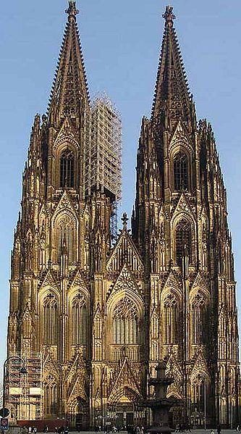
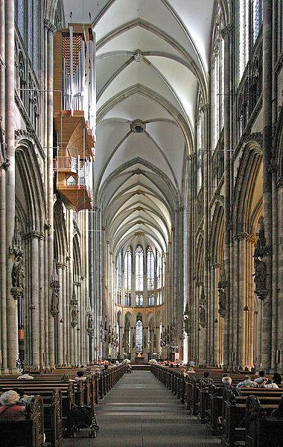
科隆大教堂

Slide 113
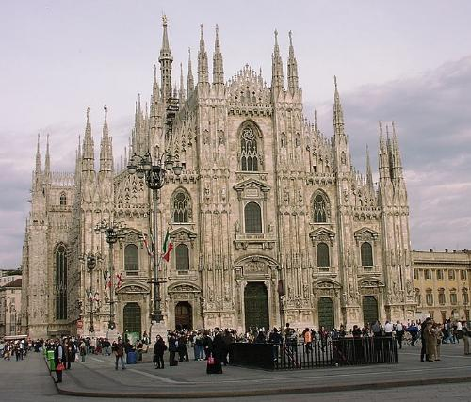


Slide 114



Slide 115



Slide 116
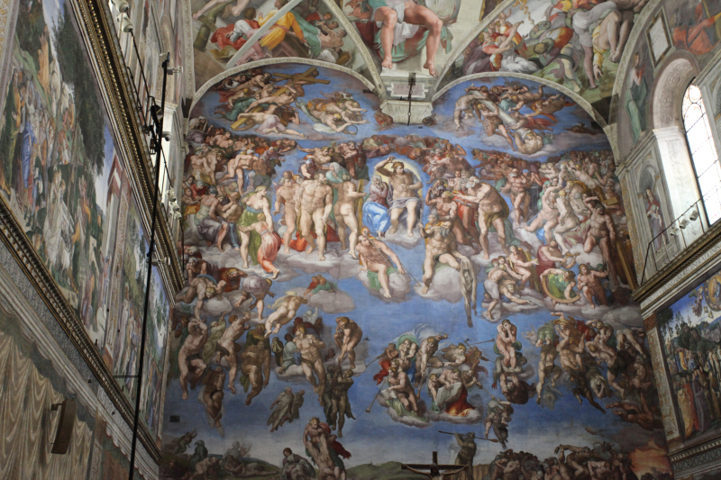
米开朗基罗-西斯廷小教堂裡世界名作穹頂畫《創世紀》、巨幅壁畫《最後的審判》 60岁-6年 200平方米 数百人物

Slide 117
10.3.1 体系结构风格的简单分类
Data-centered architectures
Data flow architectures
Call and return architectures
Object-oriented architectures
Layered architectures
注意：上述描述的体系结构风格仅仅是可用风格的一小部分，可以选用最适合该系统需求的系统架构风格和（或）风格的组合，多数情况下，会有多种选择。
© 2010 Sichuan University All rights reserved. | Confidential

Slide 118
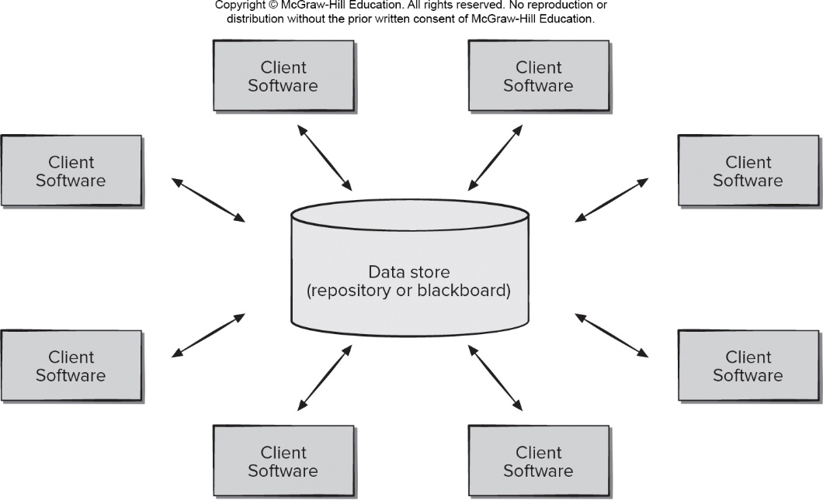
A. Data-Centered Architecture
例如：C/S，MIS
© 2010 Sichuan University All rights reserved. | Confidential

Slide 119
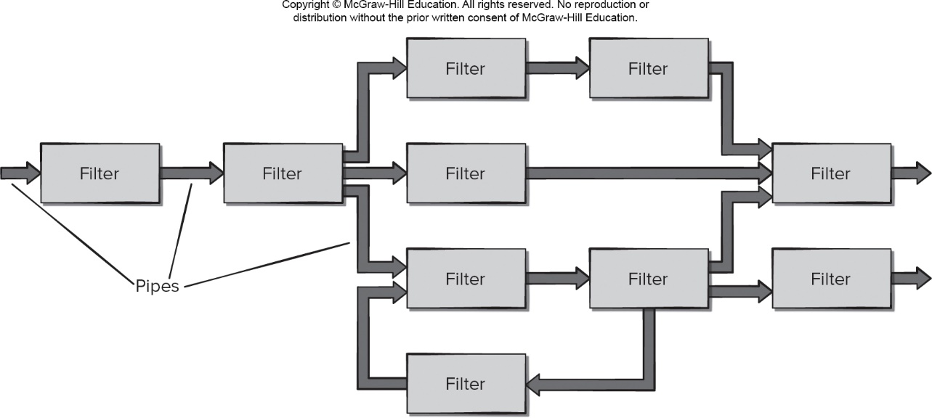
B. Data Flow Architecture
批处理，处理流（整体串行，局部并行）
© 2010 Sichuan University All rights reserved. | Confidential

Slide 120
C. Call and Return Architecture
包括很多子风格：
Main program/subprogram architectures
主程序-子程序体系结构 Figure 10.3
Remote procedure call architectures
远程过程调用体系结构
…
© 2010 Sichuan University All rights reserved. | Confidential

Slide 121
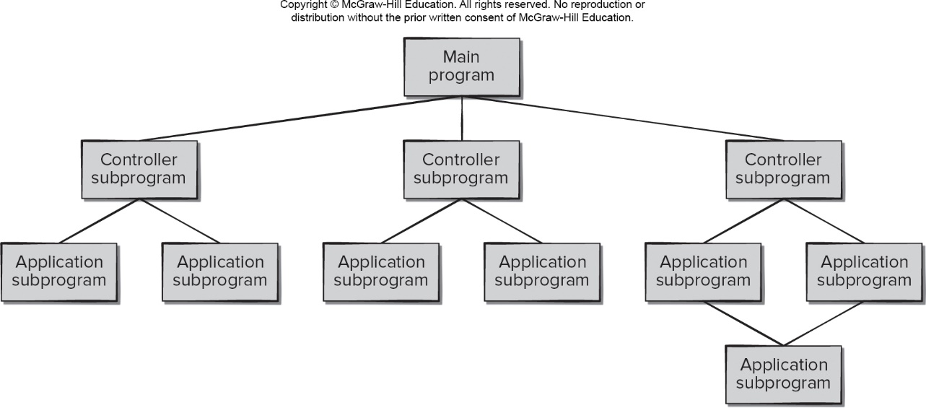
图例：Call and Return Architecture-pass
例如：标准的结构化程序设计
© 2010 Sichuan University All rights reserved. | Confidential

Slide 122
D. Object-oriented Architecture
© 2010 Sichuan University All rights reserved. | Confidential

Slide 123
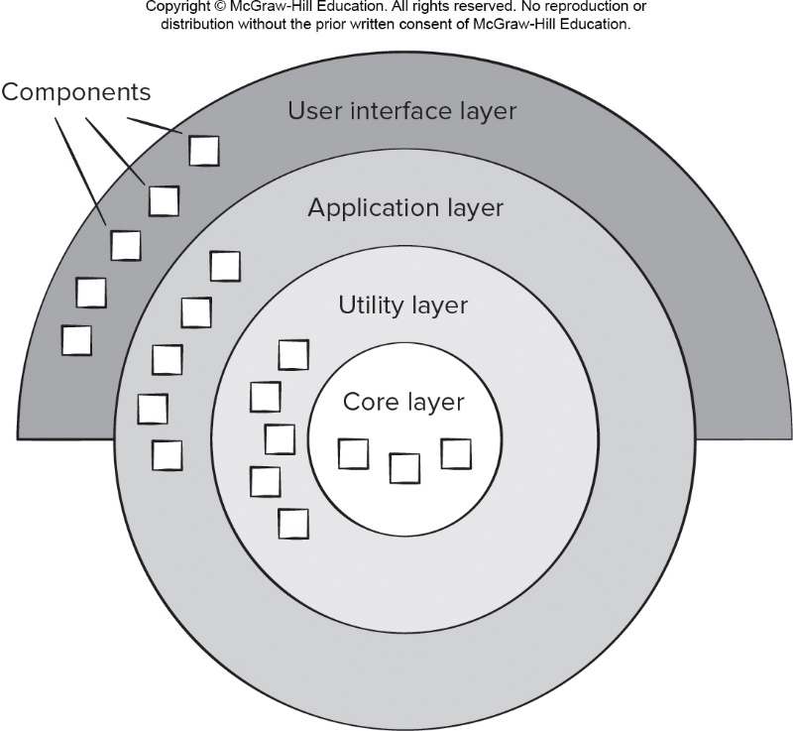
E. Layered Architecture （层次架构）
用户界面层、应用层、工具层（中间层）、内核层
© 2010 Sichuan University All rights reserved. | Confidential

Slide 124
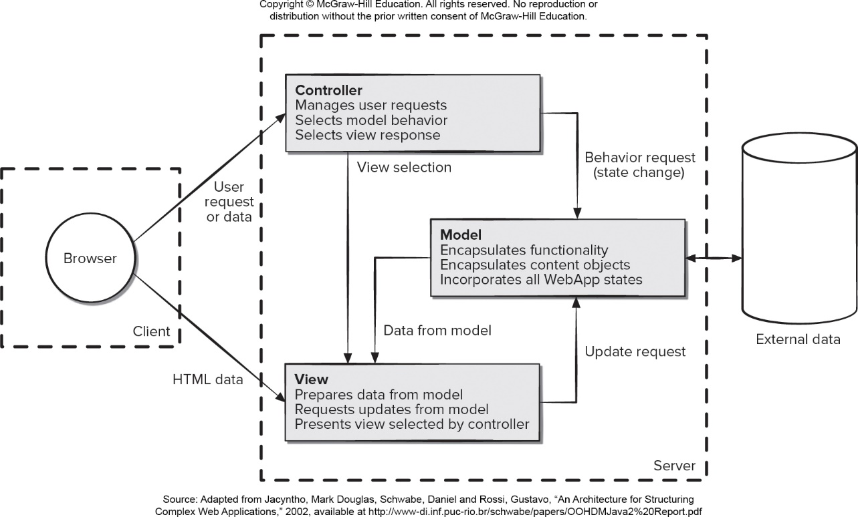
Model View Controller Architecture
Access the text alternative for slide images.

Slide 125
MVC：Model 模型、View 视图，及 Controller 控制器。
View：视图，为用户提供使用界面，与用户直接进行交互。
Model：模型，承载数据，并对用户提交请求进行计算的模块。其分为两类： 一类称为数据承载 Bean：实体类，专门用户承载业务数据的，如 Student、User 等 一类称为业务处理 Bean：指 Service 或 Dao 对象，专门用于处理用户提交请求的。
Controller：控制器，用于将用户请求转发给相应的 Model 进行处理，并根据 Model 的计算结果向用户提供相应响应。
MVC 架构程序的工作流程：
用户通过 View 页面向服务端提出请求，可以是表单请求、超链接请求、AJAX 请求等
服务端 Controller 控制器接收到请求后对请求进行解析，找到相应的 Model 对用户请求进行处理
Model 处理后，将处理结果再交给 Controller
Controller 在接到处理结果后，根据处理结果找到要作为向客户端发回的响应 View 页面。页面经渲染（数据填充）后，再发送给客户端。

Slide 126
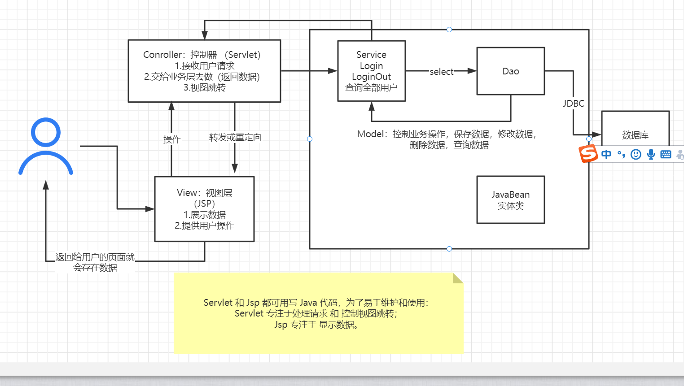
MVC：Model 模型、View 视图，及 Controller 控制器。
MVC是将业务逻辑、数据、显示分离的方法来组织代码，MVC主要作用是降低了视图与业务逻辑间的双向偶合，MVC不是一种设计模式，MVC是一种架构模式。

Slide 127
Typical Layering Approach 参考
Specific functionality
Distinct application subsystems that make up an application — contains the value adding software developed by the organization.
Application
软件层次：
应用层
业务层
中间层（件）
核心 (Server OS）
Business specific — contains a number of reusable subsystems specific to the type of business.
Business-Specific
Middleware — offers subsystems for utility classes and platform-independent services for distributed object computing in heterogeneous environments and so on.
Middleware
System software — contains the software for the actual infrastructure such as operating systems, interfaces to specific hardware, device drivers, and so on.
General functionality
System Software
Notes:
This is a repeat of the slide first introduced in Architectural Analysis. It is included here as a review.
During Architectural Analysis, the focus was on the upper-level layers (that is, the application and business-specific layers). During Identify Design Elements, the focus is on the lower-level layers.
The layering principles originally described for packages also apply to subsystems.
This graphic comes from RUP.

Slide 128
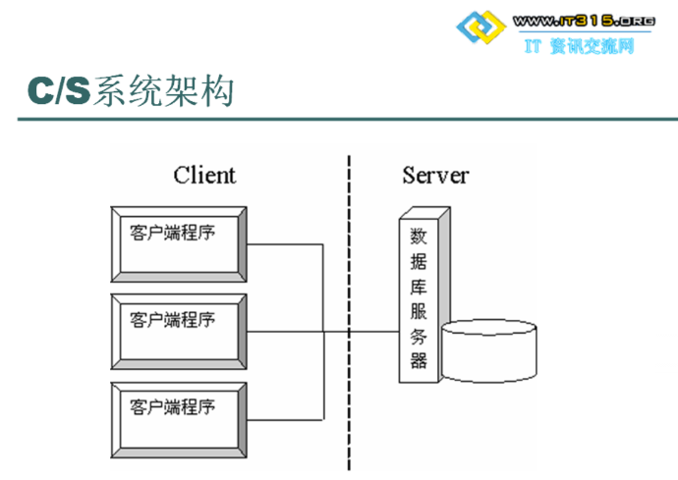
Client-Server Style 补充
Components are clients and servers
Servers do not know number or identities of clients
Clients know server’s identity
Connectors are RPC（远程调用）-based network interaction protocols

Slide 129
Client-Server Style 补充
Components are clients and servers
Servers do not know number or identities of clients
Clients know server’s identity
Connectors are RPC（远程调用）-based network interaction protocols

Slide 130
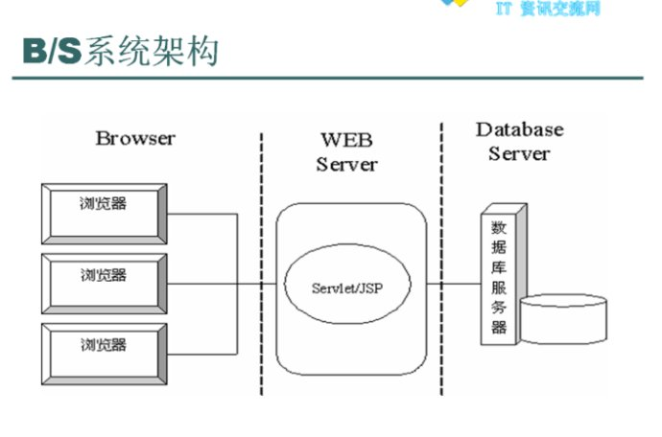
Browse-Server Style 补充（两层或多层）

Slide 131
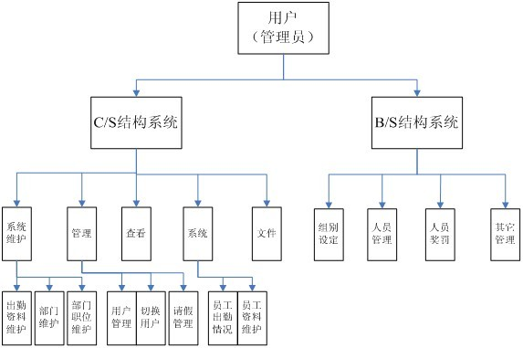
补充-参考

Slide 132
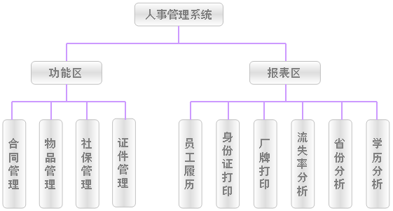
补充-参考

Slide 133
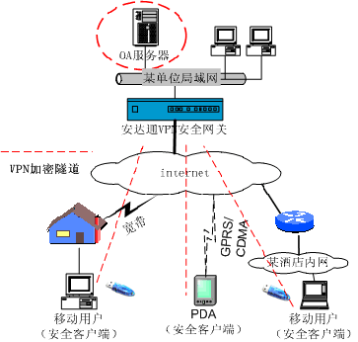
补充-参考

Slide 134
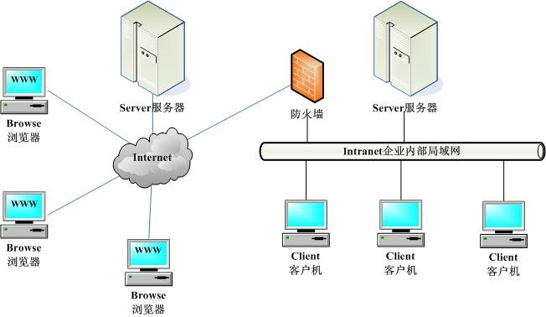
补充-参考

Slide 135
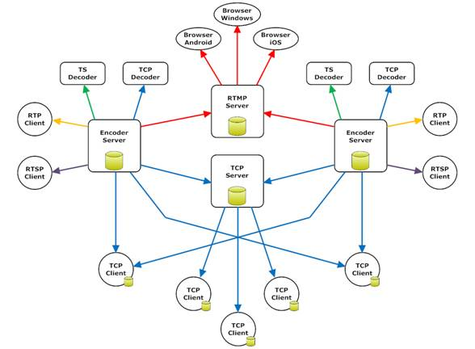
补充-参考

Slide 136
10.3.3 Architectural Organization and Refinement
Control.
How is control managed within the architecture?
Does a distinct control hierarchy exist, and if so, what is the role of components within this control hierarchy?
How do components transfer control within the system?
How is control shared among components?
What is the control topology (that is, the geometric form that the control takes)?
Is control synchronized同步, or do components operate asynchronously异步?

Slide 137
10.3.3 Architectural Organization and Refinement
Data.
How are data communicated between components?
Is the flow of data continuous, or are data objects passed to the system sporadically?
What is the mode of data transfer?
Do data components exist, and if so, what is their role?
How do functional components interact with data components?
Are data components passive or active?
How do data and control interact within the system?

Slide 138
10.4 Architectural Considerations
Economy – The best software is uncluttered and relies on abstraction to reduce unnecessary detail.
Visibility – Architectural decisions and the reasons for them should be obvious to software engineers who examine the model at a later time.
Spacing – Separation of concerns in a design without introducing hidden dependencies.
Symmetry – Architectural symmetry implies that a system is consistent and balanced in its attributes.对称性
Emergence – Emergent, self-organized behavior and control. （实时性要求）
These slides are designed to accompany Software Engineering: A Practitioner’s Approach, 8/e (McGraw-Hill, 2014). Slides copyright 2014 by Roger Pressman.

Slide 139
The Steps of Architectural Design

Slide 140
10.6 The Steps of Architectural Design（重要）
Representing the System in Context
环境表示ACD- Architectural Context Diagram
Defining Archetypes
定义原型，定义核心结构（定义风格、模式等，也可以理解为一些相对较小的原型集合）
Refining the Architecture into Components
精化为构件
Describing Instantiations of the System
描述系统实例（进一步精化）
© 2010 Sichuan University All rights reserved. | Confidential

Slide 141
Architectural Design（同前页）
The software must be placed into context
定义软件环境，包括外部实体、接口等
the design should define the external entities (other systems, devices, people) that the software interacts with and the nature of the interaction
A set of architectural archetypes should be identified
定义一系列架构的原型（子架构），如类、模式等（也可以理解为一些相对较小的原型集合）
An archetype原型 is an abstraction (similar to a class) that represents one element of system behavior, it’s core abstract classes or patterns of system)
The designer specifies the structure of the system by defining and refining software components that implement each archetype 指定系统的结构（定义、细化每个原型的构件）
© 2010 Sichuan University All rights reserved. | Confidential

Slide 142
10.6.1 Representing the system in context
The generic structure of the architecture of ACD
Architectural Context Diagram-ACD体系结构环境图
Superordinate上级 systems （比如：操作系统、网络等）
Subordinate下级 systems （控制的下级对象，比如输出）
Peer-level同级 systems （同级相互作用、影响的系统）
Actors参与者 （人、设备）
See Next Page Figure 10.6: ACD for the SafeHome security function
© 2010 Sichuan University All rights reserved. | Confidential

Slide 143
Architectural Context Diagram (ACD)
© 2010 Sichuan University All rights reserved. | Confidential

Slide 144
10.6.2 Archetypes
An archetype is a class or pattern that represents a core abstraction that is critical to the design of an architecture for the target system
是表示核心抽象的类或模式
一组原型的集合（ A set of architectural archetypes ）构成系统体系结构的核心
© 2010 Sichuan University All rights reserved. | Confidential

Slide 145
10.6.2 Archetypes
定义原型是表示核心抽象的类或模式 （参考架构风格与模式，在实例化为本应用的核心：类或模式）
例：Figure 10.7 UML relationships for SafeHome security function archetypes（定义了4个核心类）
Node-结点（表示系统输入[探测器]和输出元素[指示器]的内聚集合）
Detector-探测器(所有传感设备的抽象)
Indicator-指示器(所有报警设备的抽象)
Controller-控制器(允许结点报警或撤销报警)
注：图10.7是构成体系结构基础的原型，随着设计的进行，这些抽象必须进一步求精，细化。
© 2010 Sichuan University All rights reserved. | Confidential

Slide 146
Archetypes（举例）
© 2010 Sichuan University All rights reserved. | Confidential

Slide 147
10.6.3 Refine the Architecture into components
As the software architecture is refined into components, the structure of the system begins to emerge
例：Figure 10.8 Overall architectural structure for SafeHome security function with top-level components
外部通信管理
控制面板处理
探测器管理
警报处理
注：每个顶层构件都必须经过反复的迭代精化
© 2010 Sichuan University All rights reserved. | Confidential

Slide 148
Component Structure 构建模块结构图
© 2010 Sichuan University All rights reserved. | Confidential

Slide 149
10.6.4 Describing Instantiations of the system
Refined Component Structure
© 2010 Sichuan University All rights reserved. | Confidential

Slide 150
架构设计主要成果
1、数据架构
2、系统结构图
3、模块结构图
4、部署图
5、细化构件描述
6、其它
© 2010 Sichuan University All rights reserved. | Confidential

Slide 151
10.7 Assessing Alternative Architectural Designs
评估可选的体系结构设计
In their book on the evaluation of software architectures,“To put it bluntly, an architecture is a bet, a wager on the success of a system.”
The big question for a software architect and the software engineers who will work to build a system is simple: Will the architectural bet pay off?
To help answer this question, architectural design should result in a number of architectural alternatives that are each assessed to determine which is the most appropriate for the problem to be solved.
© 2010 Sichuan University All rights reserved. | Confidential

Slide 152
Architectural Tradeoff Analysis：
The Software Engineering Institute (SEI) has developed an architecture trade-off analysis method (ATAM) that establishes an iterative evaluation process for software architectures. The design analysis activities that follow are performed iteratively:
1. Collect scenarios.
2. Elicit requirements, constraints, and environment description.
3. Describe the architectural styles/patterns that have been chosen to address the scenarios and requirements:
• module view
• process view
• data flow view
4. Evaluate quality attributes by considered each attribute in isolation.
5. Identify the sensitivity of quality attributes to various architectural attributes for a specific architectural style.
6. Critique candidate architectures (developed in step 3) using the sensitivity analysis conducted in step 5.
These slides are designed to accompany Software Engineering: A Practitioner’s Approach, 8/e (McGraw-Hill, 2014). Slides copyright 2014 by Roger Pressman.

Slide 153
10.7.1 Architecture Reviews（参考）
Assess the ability of the software architecture to meet the systems quality requirements and identify potential risks
Have the potential to reduce project costs by detecting design problems early
Often make use of experience-based reviews, prototype evaluation, and scenario reviews, and checklists
These slides are designed to accompany Software Engineering: A Practitioner’s Approach, 8/e (McGraw-Hill, 2014). Slides copyright 2014 by Roger Pressman.

Slide 154
10.7.2 Pattern-based Architectural Reviews
Identify and discuss the quality attributes by walking through the use cases.
Discuss a diagram of system’s architecture in relation to its requirements.
Identify the architecture patterns used and match the system’s structure to the patterns’ structure.
Use existing documentation and use cases to determine each pattern’s effect on quality attributes.
Identify all quality issues raised by architecture patterns used in the design.
Develop a short summary of issues uncovered during the meeting and make revisions to the walking skeleton.

Slide 155
设计文档模版
一． 引言
1.编写目的
2.项目背景（略）
3.定义：在该概要设计说明书中的专门术语有：XXX
4.参考资料
二． 任务概述
1.目标
2.运行环境：Win，iOS， Android。
3.需求概述（略）
4.条件与限制
三． 总体设计
1．总体架构
系统的总体结构图、数据流程图等：
2．系统主要功能和模块设计
部署图，各模块功能描述，程序、算法流程（包括协作图、类图等）
四． 数据设计
1.数据结构（数据表、数据库）设计
OO-类的设计
2.物理结构设计
3.数据结构与程序的关系
五． 接口设计
1.用户界面
2.外部接口（略）
3.内部接口（略）
六． 其它
1.运行设计
2.出错处理设计
3.安全保密设计
4.维护设计
© 2010 Sichuan University All rights reserved. | Confidential

Slide 156
Example: ATC Design
Architecture
Module
Interface
Data
…
ATC Design详见WORD文档
© 2010 Sichuan University All rights reserved. | Confidential

Slide 157
Summary
Software Architecture: the structure of the system, which comprise software components, the externally visible properties of those components and the relationships among them.（架构包括软件构件，构件的属性和构件之间的相互关系）
The architecture is not the operational software. Rather, it is a representation that enables a software engineer to:
analyze the effectiveness of the design in meeting its stated requirements,
consider architectural alternatives at a stage when making design changes is still relatively easy, and
reduce the risks associated with the construction of the software.
© 2010 Sichuan University All rights reserved. | Confidential

Slide 158
Summary
系统体系结构提供了待构造系统的整体视图，它描述软件构件的结构和组织，构件的特点以及构件之间的连接。
软件构件包括程序模块和程序操作的各种数据表示，因此数据设计是软件体系结构设计的一个组成部分。
体系结构设计注重于早期的设计决策
© 2010 Sichuan University All rights reserved. | Confidential

Slide 159
Summary
A number of different architectural styles and patterns are available to the software engineer and may be applied with a given architectural genre.
要了解和掌握一些风格和模式
Data-centered architectures
Data flow architectures
Call and return architectures
Object-oriented architectures
Layered architectures
© 2010 Sichuan University All rights reserved. | Confidential

Slide 160
Summary
设计步骤：
Architecture design is accomplished using four distinct steps:
The system must be represented in context （ACD）– the designer should define the external entities that the software interacts with and the nature of the interaction
The designer should identify a set of top-level abstractions, called archetypes, that represent pivotal elements of the system’s behavior or function
The design begins to move closer to the implementation domain. Components are identified and represented within the context of an architecture that supports them （refine）
Specific instantiations of the architecture are developed to “prove” the design in a real-world context
© 2010 Sichuan University All rights reserved. | Confidential

Slide 161
Answer 1-e 2-d
Exercise
An architectural style encompasses which of the following elements?
constraints 约束
set of components
semantic models语义模型
syntactic models语法模型
a, b and c
During the process of modeling the system in context, systems that interact with the target system are not represented as
Peer-level systems
Subordinate systems
Super-ordinate systems
Working systems
© 2010 Sichuan University All rights reserved. | Confidential

Slide 162
Answer 3-e 4-b
Exercise
3. A successful application of transform or transaction mapping to create an architectural design is supplemented by （不做）
entity relationship diagram
module interface descriptions
processing narratives for each module
test case for each module
Both b and c
4. The best representation of system architecture is an operational software prototype.
a. True
b. False
© 2010 Sichuan University All rights reserved. | Confidential

Slide 163
Homework （ 2023.10.19）
1.Why is architecture important?
2. What are the elements that make up a software architectural style?
3. What is an archetype?
© 2010 Sichuan University All rights reserved. | Confidential

Slide 164
Chapter 11 Component-Level Design
Content
What is component?
Design class-based component
Conducting component-level design（ class-based ）
Design conventional components
Open-Closed Principle (O C P)..
Liskov Substitution Principle (L S P)
Dependency Inversion Principle (D I P)”
Interface Segregation Principle
criteria ，surreptitiously
© 2010 Sichuan University All rights reserved. | Confidential

Slide 165
11.1 What is a Component?
A modular, deployable, and replaceable part of a system that encapsulates implementation and exposes a set of interfaces.
构件是:模块化的、可部署的和可替换的部件，该部件封装了操作实现和接口
© 2010 Sichuan University All rights reserved. | Confidential

Slide 166
11.1 What is a Component?
OO view: a component contains a set of collaborating classes
Conventional view: a functional element of a program (=module) that incorporates processing logic, the internal data structures that are required to implement the processing logic, and an interface that enables the component to be invoked and data to be passed to it
Process-related view: building systems out of reusable software components or design patterns selected from a catalog (component-based software engineering).
© 2010 Sichuan University All rights reserved. | Confidential

Slide 167
11.1.1 An Object-Oriented View
OO view: a component contains a set of collaborating classes
Each class within a component has been fully elaborated to include all attributes and operations that are relevant to its implementation
All interfaces that enable the classes to communicate and collaborate with other design class must also be defined
要从需求分析模型开始，将分析类转化为设计表示（细化）
© 2010 Sichuan University All rights reserved. | Confidential

Slide 168
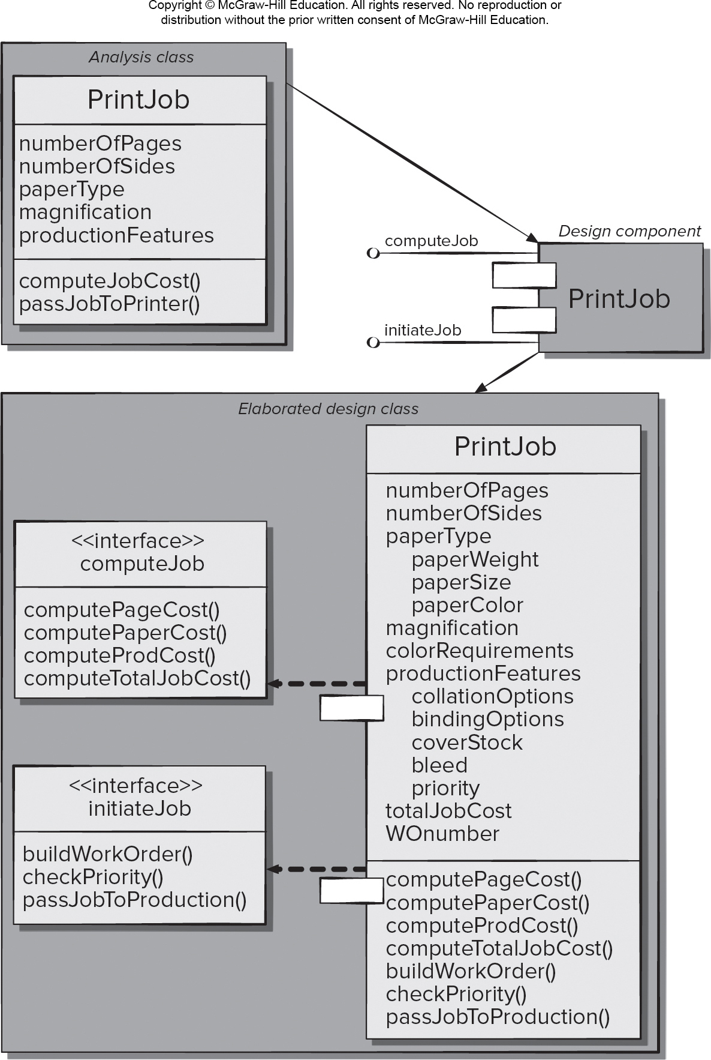
OO Component-细化每个构件
Printjob构件有2个接口
computeJob，initiateJob
（1）initiateJob-
把任务传给设备
buildWorkOrder()
checkPriority()
passJobtoProduction()
（2）computeJob-
对任务进行定价
computePageCost
computePaperCost
computeProdCost
computeTotalJobCost
© 2010 Sichuan University All rights reserved. | Confidential

Slide 169
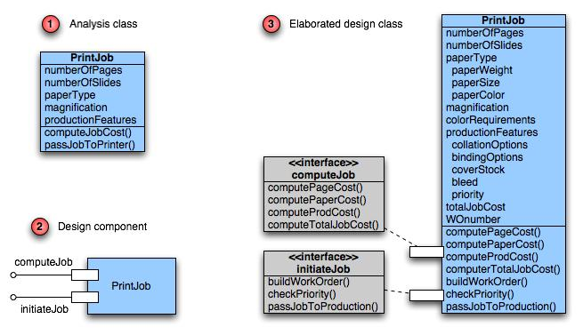
Class Elaboration 三步：1-分析类 2-构件设计 3-细化

Slide 170
11.1.2 Conventional view
一个构件就是程序的一个功能模块（处理逻辑，内部数据结构和构件能调用和实现数据传递的接口）
传统的软件构件也来源于分析模型（分析模型中的数据流作为导出构件的基础），数据流图最底层的每个变换都被映射为某一层次上的模块。一般来说，控制构件位于顶层附件，而问题域构件则倾向于层次结构的底层。
每个构件需要细化，采用功能独立性的设计概念
© 2010 Sichuan University All rights reserved. | Confidential

Slide 171
11.1.2 Conventional view
Conventional view: a functional element of a program that incorporates processing logic, the internal data structures that are required to implement the processing logic, and an interface that enables the component to be invoked and data to be passed to it
传统构件也称为模块，作为软件体系结构的一部分，它承担如下3个角色之一（三种构件）
control component 控制构件（上层）：
协调问题域中所有其他构件的调用
problem domain component 问题域构件（下层）：
实现客户需要的全部功能或部分功能
infrastructure component 基础设施构件: (辅助)
负责完成问题域中所需支持处理的功能
函数的参数（接口）、处理逻辑、数据结构
© 2010 Sichuan University All rights reserved. | Confidential

Slide 172
Conventional Component（构件的细化）
Job
Management
system
Read
print job
data
Select
jobmgmt
function
Develop
job cost
Build
work order
Send job
to
production
Compute
page cost
Compute
paper cost
Compute
prod cost
Check
priority
Pass job to
production
© 2010 Sichuan University All rights reserved. | Confidential

Slide 173
Refine Component
ComputePageCost-2个接口：
getJobData-访问相关打印任务数据
accessCostDB-访问印刷成本数据库

Slide 174
11.2 Design class-based components
Focuses on the elaboration of problem domain specific classes the definition and refinement of infrastructure classes contained in the requirements model
The detailed description of the attributes, operations, and interfaces used by these classes is the design detail required as a precursor to the construction activity.
构件级设计主要关注“需求模型中问题域特定类的细化和基础设施类的定义和细化”
就是类的定义和细化，类之间的接口定义和细化
© 2010 Sichuan University All rights reserved. | Confidential

Slide 175
Basic Component Design Principles
Open-Closed Principle (O C P). “A module [component] should be open for extension but closed for modification.
Liskov Substitution Principle (L S P). “Subclasses should be substitutable for their base classes.
Dependency Inversion Principle (D I P). “Depend on abstractions. Do not depend on concretions.”
Interface Segregation Principle (I S P). “Many client-specific interfaces are better than one general purpose interface.
Release Reuse Equivalency Principle (R E P). “The granule of reuse is the granule of release.”
Common Closure Principle (C C P). “Classes that change together belong together.”
Common Reuse Principle (C R P). “Classes that aren’t reused together should not be grouped together.”

Slide 176
11.2.1 Basic Design Principles
The Open-Closed Principle (OCP).开闭原则
“A module [component] should be open for extension but closed for modification. 对扩展具有开放性，对修改具有封闭性
The Liskov Substitution Principle (LSP). 替换原则
“Subclasses should be substitutable for their base classes.子类可以替换它们的基类
Dependency Inversion Principle (DIP). 依赖倒置原则
“Depend on abstractions. Do not depend on concretions.” 依赖于抽象（抽象类），而不是依赖于具体实现，降低了客户程序与实现细节的耦合度。
The Interface Segregation Principle (ISP). 接口分离原则
“Many client-specific interfaces are better than one general purpose interface. 设计多个用户接口比一个通用接口更好
© 2010 Sichuan University All rights reserved. | Confidential

Slide 177
11.2.1 Basic Design Principles
“开-闭”原则也就是“对可变性的封装原则”（Principle of Encapsulation of Variation ，EVP）
实现“开-闭”原则的关键步骤是抽象化。基类与子类之间的继承关系就是抽象化的体现。因此，里氏替换原则是对实现抽象化的具体步骤的规范。
“开-闭”原则与依赖倒置原则是目标和手段的关系。如果说开闭原则是目标,依赖倒置原则是到达“开闭”原则的手段。如果要达到最好的“开闭”原则,就要尽量的遵守依赖倒置原则，依赖倒置原则是对“抽象化”的最好规范。
以抽象方式耦合是依赖倒置原则的关键。抽象耦合关系总要涉及具体类从抽象类继承，并且需要保证在任何引用到基类的地方都可以改换成其子类，因此，里氏替换原则是依赖倒转原则的基础。（程序扩展很容易，是面向对象的重要标志）
接口隔离原则：表明客户端不应该被强迫实现一些他们不会使用的接口，应该把胖接口中的方法分组，然后用多个接口代替它，每个接口服务于一个子模块。简单地说，就是使用多个专门的接口比使用单个接口要好得多。 也就是说，一个类对另外一个类的依赖性应当是建立在最小的接口上。
© 2010 Sichuan University All rights reserved. | Confidential

Slide 178
Example: The Open-Closed Principle (OCP).
构件无需对内部进行修改就可以扩展
Figure 11.4 following the OCP （对于不同传感器， sensor接口都向Detector构件呈现一致的视图:若要添加新的传感器，只需增加一个Sensor的子类，Detector构件无需任何改变）
<<interface>>
Sensor
read()
enable()
disable()
test()
Detector
Window/
Door Sensor
Smoke Sensor
Motion Detector
Heat Sensor
CO2 Sensor
© 2010 Sichuan University All rights reserved. | Confidential

Slide 179
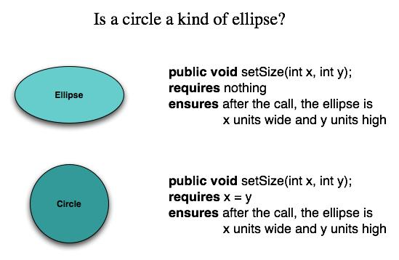
Example: The Liskov Substitution Principle (LSP)
替换原则
“Subclasses should be substitutable for their base classes.子类可以替换它们的基类
基类-椭圆
子类-园
长方形-正方形
娣，美人也，爱娣，非爱美人也….
盗，人也；恶盗，非恶人也
© 2010 Sichuan University All rights reserved. | Confidential

Slide 180
Example: The Liskov Substitution Principle (LSP)
替换原则 ：子类可以替换它们的基类
在进行设计时，我们尽量从抽象类继承，而不是从具体类继承
即：子类应该可以替换任何基类能够出现的地方，并且经过替换以后，代码还能正常工作。另外，不应该在代码中出现if/else之类对子类类型进行判断的条件。里氏替换原则LSP是使代码符合开闭原则的一个重要保证。正是由于子类型的可替换性才使得父类型的模块在无需修改的情况下就可以扩展。
在很多情况下，在设计初期我们类之间的关系不是很明确，LSP则给了我们一个判断和设计类之间关系的基准：需不需要继承，以及怎样设计继承关系。
© 2010 Sichuan University All rights reserved. | Confidential

Slide 181
Example: The Liskov Substitution Principle (LSP)
举例：
在数学领域里，正方形毫无疑问是长方形，它是一个长宽相等的长方形。所以，应该让正方形继承自长方形。
如果直接继承，不符合里氏代换原则
在进行设计时，我们尽量从抽象类继承，而不是从具体类继承。为了符合里氏代换原则，我们可以为长方形和正方形创建一个父类Base，并在其中定义好共有的属性。保证这个父类的代码不改变。
简单的理解为一个软件实体如果使用的是一个父类，那么一定适用于其子类，而且它察觉不出父类对象和子类对象的区别。也就是说，软件里面，把父类都替换成它的子类，程序的行为没有变化。
© 2010 Sichuan University All rights reserved. | Confidential

Slide 182
Example: Dependency Inversion Principle (DIP)
依赖倒置原则 （一个良好的设计就是良好的抽象）
“Depend on abstractions. Do not depend on concretions.” 依赖于抽象（抽象类），而不是依赖于具体实现，降低了客户程序与实现细节的耦合度。
抽象可以比较容易地对设计进行扩展，构件依赖的其他具体构件（而不是抽象的类）越多，扩展起来就越困难
（与OCP原则的理念一致）
© 2010 Sichuan University All rights reserved. | Confidential

Slide 183
Dependency Inversion Principle（参考）
依赖倒转原则是面向对象的重要标志：
设计（编程）重点考虑的是如何针对抽象编程而不是针对细节编程，即程序的所有依赖关系都终止于抽象类或接口。那就是面向对象设计，反之那就是过程化设计。

Slide 184
Example: The Interface Segregation Principle (ISP)
接口分离原则
“Many client-specific interfaces are better than one general purpose interface. 设计多个用户接口比一个通用接口更好
具体而言，接口分离原则体现在：
接口应该是内聚的，应该避免“胖”接口。一个类对另外一个类的依赖应该建立在最小的接口上，不要强迫依赖不用的方法，这是一种接口污染。
© 2010 Sichuan University All rights reserved. | Confidential

Slide 185
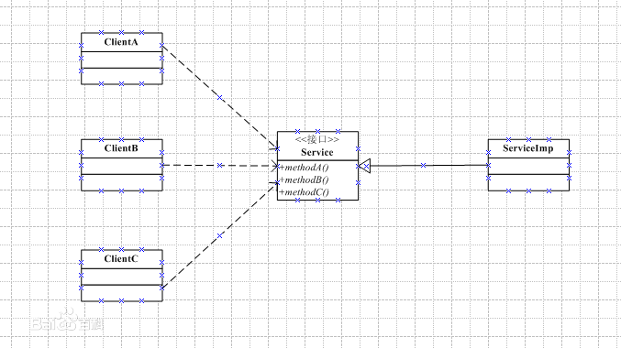
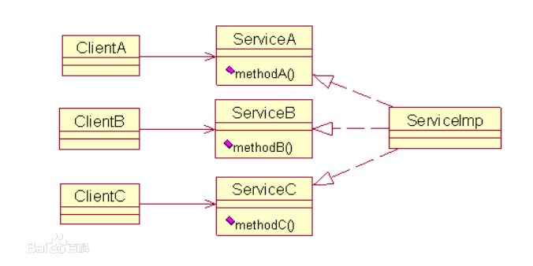
Example: The Interface Segregation Principle (ISP)
接口分离原则
一个接口不需要提供太多的行为，一个接口应该只提供一种对外的功能，不应该把所有的操作都封装到一个接口当中（右图，将Service，分离为ServiceA,ServiceB,ServiceC）
© 2010 Sichuan University All rights reserved. | Confidential

Slide 186
Basic Design Principles -2
Additional packaging principles: （构件打包原则）
The Release Reuse Equivalency Principle (REP). 发布复用等价性原则
“The granule of reuse is the granule of release.” （建立一个发布控制系统，以支持和维护各种老版本，发布的复用版本内容一致、兼容）
The Common Closure Principle (CCP). 共同封装原则
“Classes that change together belong together.”
The Common Reuse Principle (CRP). 共同复用原则
“Classes that aren’t reused together should not be grouped together.”
© 2010 Sichuan University All rights reserved. | Confidential

Slide 187
11.2.2 Design Guidelines-参考
构件、接口的命名规范，图形化表示形式；依赖与继承表示形式
Components
Naming conventions命名约定 should be established for components that are specified as part of the architectural model and then refined and elaborated as part of the component-level model
Interfaces
Interfaces provide important information about communication and collaboration (as well as helping us to achieve the OCP)
Dependencies and Inheritance
it is a good idea to model dependencies from left to right and inheritance from bottom (derived classes) to top (base classes). 依赖关系从左至右；继承关系自底向上
© 2010 Sichuan University All rights reserved. | Confidential

Slide 188
Review

Slide 189
11.2.3 Cohesion
Conventional view:
the “single-mindedness” of a module 功能单一性
OO view: （封装相互密切关联的属性和操作）
cohesion implies that a component or class encapsulates only attributes and operations that are closely related to one another and to the class or component itself
© 2010 Sichuan University All rights reserved. | Confidential

Slide 190
11.2.3 Cohesion
Levels of cohesion:
Functional - module performs one and only one computation.
Layer - occurs when a higher layer accesses the services of a lower layer, but lower layers do not access higher layers.
Communicational - All operations that access the same data are defined within one class.
Classes and components that exhibit functional, layer, and communicational cohesion are relatively easy to implement, test and maintain.
© 2010 Sichuan University All rights reserved. | Confidential

Slide 191
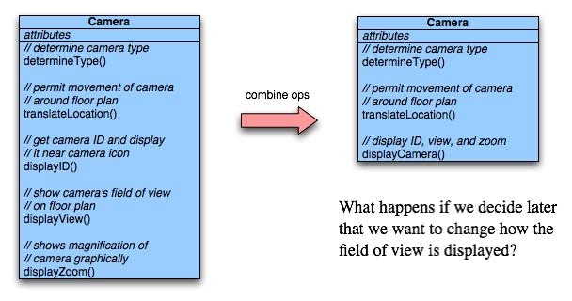
Functional Cohesion
Typically applies to operations. Occurs when a module performs one and only one computation and then returns a result.
一个模块只完成某一组特定操作并返回结果

Slide 192
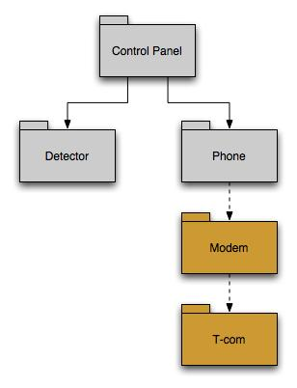
Layer Cohesion
Applies to packages, components, and classes.
由包、构件和类 来体现
Occurs when a higher layer can access a lower layer, but lower layers do not access higher layers.
高层能够访问底层，反之不行

Slide 193
Communicational Cohesion
All operations that access the same data are defined within one class.（访问相同数据的所有操作定义在一个类中）
In general, such classes focus solely on the data in question, accessing and storing it.
Example: A Student-Record class that adds, removes, updates, and accesses various fields of a student record for client components.

Slide 194
11.2.4 Coupling
软件必须进行内部和外部的通信，耦合必然存在
Conventional view:
The degree to which a component is connected to other components and to the external world
OO view:
a qualitative measure of the degree to which classes are connected to one another
© 2010 Sichuan University All rights reserved. | Confidential

Slide 195
11.2.4 Coupling
Levels of coupling.
Content - occurs when one component “surreptitiously偷偷地 modifies data that is internal to another component.
Control – occurs when operation A() invokes operation B() and passes a control
flag to B.
External - occurs when a component communicates or collaborates with infrastructure components.
软件必须进行内部和外部通信，耦合必然存在，应尽量降低耦合性
© 2010 Sichuan University All rights reserved. | Confidential

Slide 196
11.3 Component Level Design-I （面向对象设计）
Step 1. Identify all design classes that correspond to the problem domain.
标示出所有与问题域相对应的设计类
[功能构件]
Step 2. Identify all design classes that correspond to the infrastructure domain.
标示出所有与基础设施域相对应的设计类（主要是一些接口类和构件，比如：GUI, OS, DATABASE等）
[通常为可复用的构件]
© 2010 Sichuan University All rights reserved. | Confidential

Slide 197
11.3 Component Level Design-II （面向对象设计）
Step 3. Elaborate all design classes that are not acquired as reusable components.
细化类 ，即：详细描述实现类之间的协作（消息传递），及每个类的所有接口、属性和操作
Step 3a. Specify message details when classes or component collaborate. 在类或构件协作时说明消息的细节
Step 3b. Identify appropriate interfaces for each component. 为每个构件确定适当的接口
Step 3c. Elaborate attributes and define data types and data structures required to implement them. 细化属性，并且定义实现属性所需要的数据类型和结构
Step 3d. Describe processing flow within each operation in detail. 相信描述每个操作的处理流
© 2010 Sichuan University All rights reserved. | Confidential

Slide 198
Component-Level Design-III （面向对象设计）
Step 4. Describe persistent data sources (databases and files) and identify the classes required to manage them. 说明数据源（数据库和文件）并定义相应的类
Step 5. Develop and elaborate behavioral representations for a class or component. 开发并细化类或构件的行为表示（并不是所有的设计都需要行为表示）
Step 6. Elaborate deployment diagrams to provide additional implementation detail. 细化部署图以提供额外的实现描述
Step 7. Factor every component-level design representation and always consider alternatives. 考虑每个构件级设计表示，及其他可选方案（Review）
© 2010 Sichuan University All rights reserved. | Confidential

Slide 199
Component-Level Design（简化步骤）
标识类（从需求模型和架构设计中，提取、标识类）
标示所有问题域相对应的设计类（主要是功能方面的）
标示所有基础设施域相对应的设计类（在分析模型中可能没有涉及到），主要是一些接口类（GUI,OS,DATABASE等）
详细设计类(类的协作、 接口、属性、操作)
设计数据库、文件管理和处理需要的类
设计（细化）类的行为表示（从行为模型中导出，如果有）
设计（细化）部署图(软硬件部署)
检查与重构
标识、详细设计、部署类
© 2010 Sichuan University All rights reserved. | Confidential

Slide 200
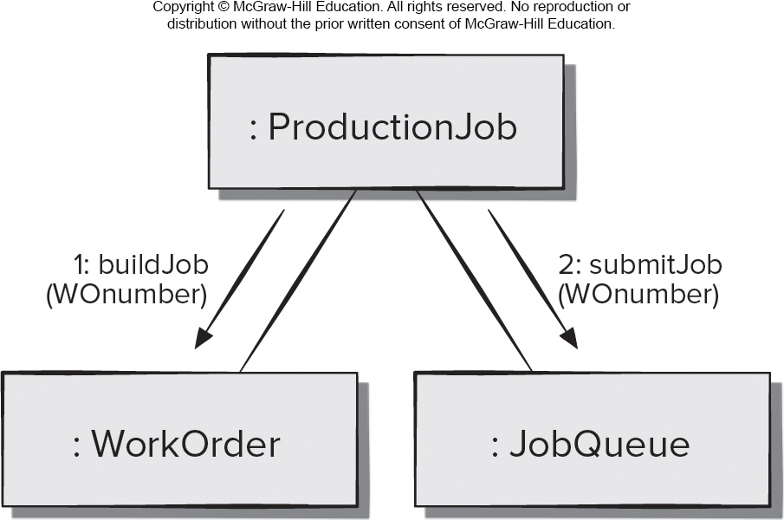
举例：在类或构件协作时说明消息的细节（参考）
Collaboration Diagram
buildJob-建立工作单 JobQueue工作队列排序（检查优先级）
3个对象相互协作，为生产线准备印刷作业，箭头表示对象间专递的消息
© 2010 Sichuan University All rights reserved. | Confidential

Slide 201
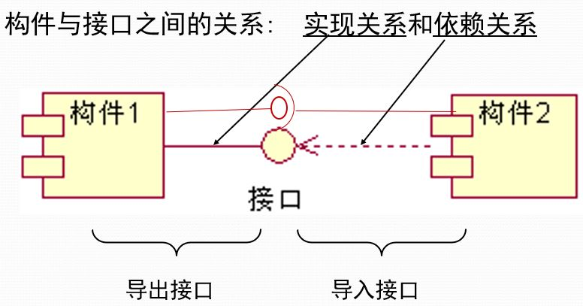
举例：构件图（参考）
构件图是用来表示系统中构件与构件之间，以及定义的类或接口与构件之间关系的图。在UML图中，接口和构件之间用实线连接表示实现关系Realization；而接口和构件之间用虚线箭头连接则表示依赖关系Dependency

Slide 202
举例：构件接口表示（参考）

Slide 203
举例：构件图（参考）

Slide 204
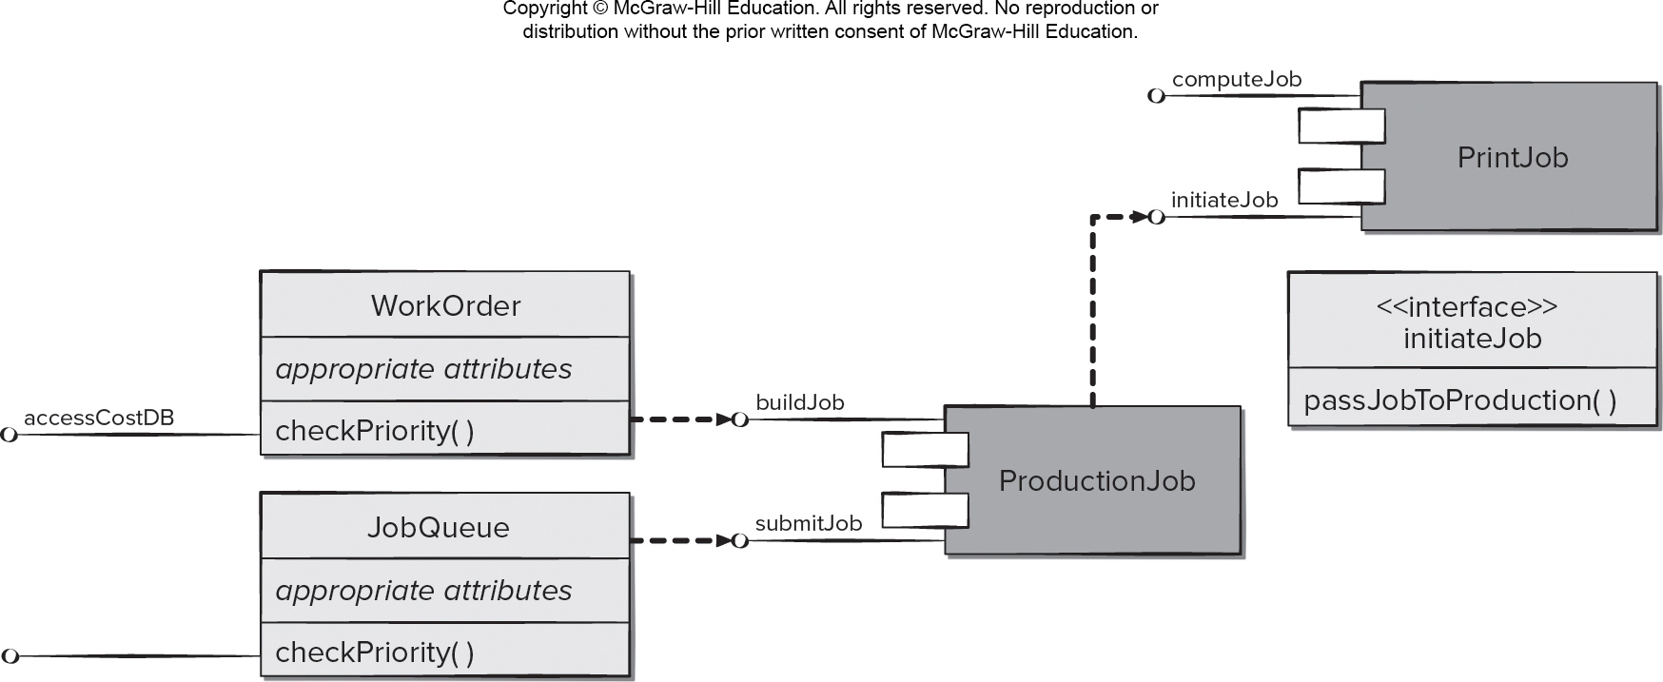
举例：为每个构件确定适当的接口（参考）
(Figure 11.7) 重构11.1 PrintJob的InitialJob接口
© 2010 Sichuan University All rights reserved. | Confidential

Slide 205
举例：详细描述每个操作的处理流程（参考）
Activity Diagram (Figure 11.8)
？问题：这个模块的输入输出是什么
Input：weight, size, color
Output: cost
© 2010 Sichuan University All rights reserved. | Confidential

Slide 206
举例：开发并且细化类或构件的行为表示（参考）
Entry/Exit：每个状态都可以定义
Do/指示符提供了一种机制，用来显示伴随此种状态的相关活动
Include/指示符提供了通过在状态定义中嵌入更多状态图细节的方式进行细化的手段
State Chart (Figure 11.9)
© 2010 Sichuan University All rights reserved. | Confidential

Slide 207
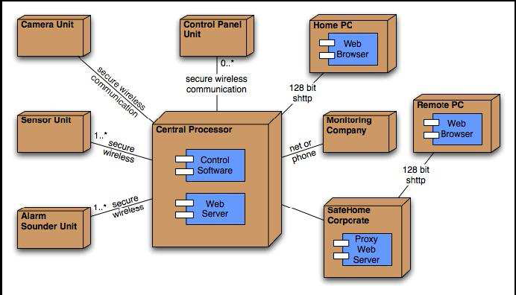
deployment diagrams
举例：细化部署图（参考）

Slide 208
11.4.3 Designing Traditional Components
顺序、条件和重复（循环）
结构化程序设计是一种重要的构件级设计技术，过程流从顶端流入，从底部流出。使用结构化设计，降低程序复杂度，增加程序可读性、可测试性和可维护性
任何程序都可以只用这3种结构化的构造来设计和实现
© 2010 Sichuan University All rights reserved. | Confidential

Slide 209
11.4.3 Designing Conventional Components
传统构件设计：
构件（模块）算法和数据结构设计，以及构件间接口设计
The design of processing logic is governed by the basic principles of algorithm design and structured programming
The design of data structures is defined by the data model developed for the system
The design of interfaces is governed by the collaborations that a component must effect
参看“ the definition of component design”-Conventional view:
a functional element of a program that incorporates processing logic, the internal data structures that are required to implement the processing logic, and an interface that enables the component to be invoked and data to be passed to it
© 2010 Sichuan University All rights reserved. | Confidential

Slide 210
Algorithm Design-算法设计
the closest design activity to coding
the approach:
review the design description for the component
use stepwise refinement to develop algorithm
use structured programming to implement procedural logic
use ‘formal methods形式化方法’ to prove logic
© 2010 Sichuan University All rights reserved. | Confidential

Slide 211
Stepwise Refinement
open
walk to door;
reach for knob;
open door;
repeat until door opens
turn knob clockwise;
walk through;
if knob doesn't turn, then
close door.
take key out;
find correct key;
insert in lock;
endif
pull/push door
move out of way;
end repeat
© 2010 Sichuan University All rights reserved. | Confidential

Slide 212
Structured Programming
uses a limited set of logical constructs:
sequence 顺序
conditional 条件— if-then-else, select-case
loops 循环— do-while, repeat until
leads to more readable, testable code
can be used in conjunction with ‘proof of correctness’
important for achieving high quality, but not enough
© 2010 Sichuan University All rights reserved. | Confidential

Slide 213
Algorithm Design Model
represents the algorithm at a level of detail that can be reviewed for quality
options:
Graphical (e.g. flowchart, box diagram)
Pseudocode 伪代码 (e.g., PDL) ... choice of many
Programming language
Decision table
Decision tree
…
© 2010 Sichuan University All rights reserved. | Confidential

Slide 214
Graphical design notation
图形化工具：
UML活动图
流程图
© 2010 Sichuan University All rights reserved. | Confidential

Slide 215
A Structured Procedural Design
© 2010 Sichuan University All rights reserved. | Confidential

Slide 216
Decision Table
© 2010 Sichuan University All rights reserved. | Confidential

Slide 217
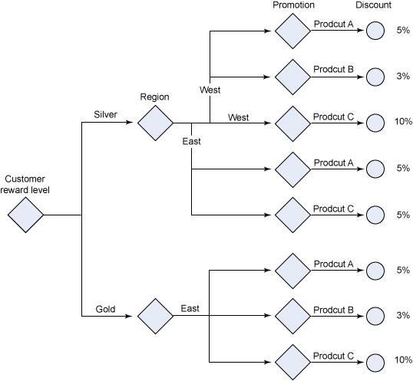
Decision Tree

Slide 218
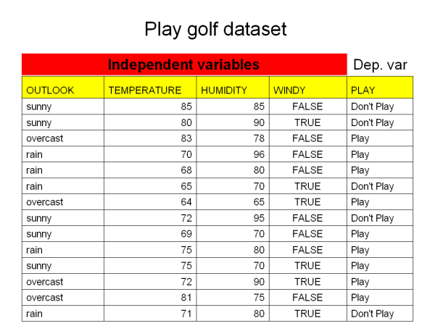
Decision Tree
打高尔夫球与天气的关系
Outlook：晴天、阴天、雨天
Temperature：温度
Humidity：湿度
Windy：风

Slide 219
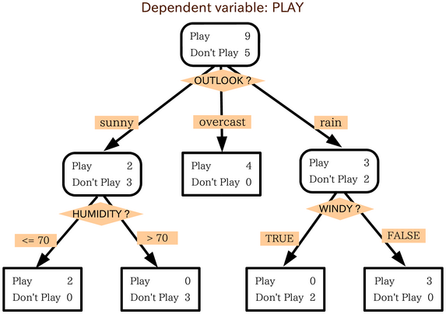
Decision Tree （与气温无关）

Slide 220
Decision Tree （与湿度无关）
1.
WINDY FASLE：P6 D2
WINDY TRUE：P3 D3 （共14个数据）
2.WINDY FASLE：P6 D2
SUNNY FASLE： P5
SUNNY TRUE： P1,D2 if T<70 P1 else D2
2.WINDY TRUE：P3 D3
SUNNY ： P1,D1 if T<80 P1 else D2
RAIN： D2
OVERCAST: P2
P:Play; D: Don’t Play

Slide 221
Program Design Language (PDL)
© 2010 Sichuan University All rights reserved. | Confidential

Slide 222
PDL-参考
基本PDL语法：构件定义、接口描述、数据声明、块结构、条件结构、重复结构和I/O结构等
包括多任务处理和（或）并发处理、中断处理、交互同步等关键字
© 2010 Sichuan University All rights reserved. | Confidential

Slide 223
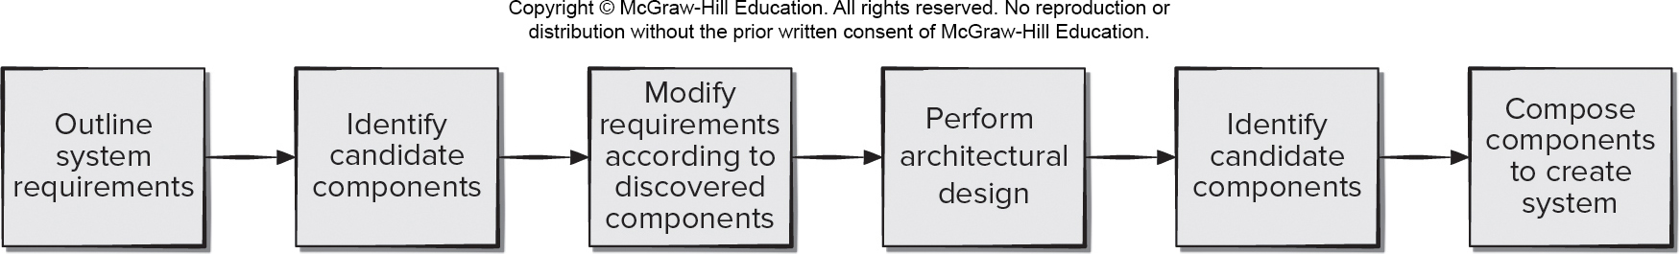
11.4.4 Component-Based Software Engineering (C B S E)
CBSE is a process that emphasizes the design and construction of computer-based systems using reusable software components
The software team asks:
Are commercial off-the-shelf (C O T S) components available to implement the requirement?
Are internally-developed reusable components available to implement the requirement?
Are the interfaces for available components compatible within the architecture of the system to be built?
Access the text alternative for slide images.

Slide 224
C B S E Benefits
Reduced lead time. It is faster to build complete applications from a pool of existing components.
Greater return on investment (R O I). Sometimes savings can be realized by purchasing components rather than redeveloping the same functionality in-house.
Leveraged costs of developing components. Reusing components in multiple applications allows the costs to be spread over multiple projects.
Enhanced quality. Components are reused and tested in many different applications.
Maintenance of component-based applications. With careful engineering, it can be relatively easy to replace obsolete淘汰 components with new or enhanced components.

Slide 225
C B S E Risks
Component selection risks. It is difficult to predict component behavior for black-box components, or there may be poor mapping of user requirements to the component architectural design.
Component integration risks. There is a lack of interoperability standards between components; this often requires the creation of “wrapper code” to interface components.
Quality risks. Unknown design assumptions made for the components makes testing more difficult, and this can affect system safety, performance, and reliability.
Security risks. A system can be used in unintended ways, and system vulnerabilities can be caused by integrating components in untested combinations.
System evolution risks. Updated components may be incompatible with user requirements or contain additional undocumented features.

Slide 226
11.5 Component Refactoring
Most developers would agree that refactoring components to improve quality is a good practice.
It is hard to convince management to expend resources fixing components that are working correctly rather than adding new functionality to them,
Changing software and failing to document the changes can lead to increasing technical debt.
Reducing this technical debt often involves architectural refactoring, which is generally perceived by developers as both costly and risky.
Developers can make of tools to examine change histories to identify the most cost effective refactoring opportunities,

Slide 227
Summary
Component DEFINITION（模块、类，实现单一功能）
模块化的、可部署的和可替换的部件，该部件封装了操作实现和接口
OO：注重细化来至于问题域和基础设施域的设计类
传统结构化程序设计：细化控制模块、问题域模块和基础设施域模块
Traditional component-level design requires the representation of data structures, interfaces and algorithms for a program module in sufficient detail to guide in the generation of programming language source code
OO component-level design : The detailed description of the attributes, operations, and interfaces used by these classes is the design detail required as a precursor to the construction activity.
© 2010 Sichuan University All rights reserved. | Confidential

Slide 228
Summary
OO: A number of important principles and concepts guide the designer as classes are elaborated
OCP开闭原则
LSP 替换原则
DIP 依赖倒置原则
ISP 接口分离原则
…
Cohesion – (高内聚)
主要包括： 功能内聚、 分层内聚、通信内聚（数据访问）、、、等
Coupling（耦合总是存在，尽量降低耦合度）
内容耦合、控制耦合、外部耦合。。。等
© 2010 Sichuan University All rights reserved. | Confidential

Slide 229
Summary
OO：构件级设计的步骤
标识类
从需求模型和架构设计中，提取、标识类
重点标识：问题域（功能）、基础设施域（接口）的类
详细设计类(类的协作、 接口、属性、操作)
设计数据库和文件管理和处理需要的类
设计（细化）类的行为表示（从行为模型中导出）
设计（细化）部署图(软硬件部署)
检查与重构
© 2010 Sichuan University All rights reserved. | Confidential

Slide 230
Answer: 1-d 2-d
Exercise
In the context of object-oriented software engineering a component contains
attributes and operations（一个类
instances of each class
roles for each actor (device or user)
a set of collaborating classes（一组类
In traditional software engineering, modules must serve in which of the following roles?
Control （控制域）component
Infrastructure（基础设施域） component
Problem domain （问题域）component
All of the above
© 2010 Sichuan University All rights reserved. | Confidential

Slide 231
Answer: 3-b 4-a
Exercise
3. Which of the following is not one of the four principles used to guide component-level design?
Dependency Inversion Principle
Parsimonious Complexity Principle
Interface Segregation Principle
Open-Closed Principle
4. Classes and components that exhibit functional, layer, or communicational cohesion are relatively easy to implement, test, and maintain.
True
False
© 2010 Sichuan University All rights reserved. | Confidential

Slide 232
Answer: 5-a 6-e
Exercise
5. In component design, elaboration does not require which of the following elements to be described in detail?
Source code
Attributes
Interfaces
Operations
b, c and d
6. In component-level design "persistent data sources" refer to
Component libraries
Databases
Files
All of the above
Both b and c
© 2010 Sichuan University All rights reserved. | Confidential

Slide 233
Answer: 7-a 8-e
Exercise
7. The object constraint language (OCL) complements UML by allowing a software engineer to use a formal grammar to construct unambiguous statements about design model elements.
True
False
(PASS)
8. Which of these criteria are useful in assessing the effectiveness of a particular design（详细设计） notation?
a. maintainability b. modularity
c. simplicity d. size e. a, b, and c
© 2010 Sichuan University All rights reserved. | Confidential

Slide 234
Homework （2023-10-26）
1.How does the object-oriented view of component-level design differ from the traditional view?
2.Describe the differences between the software engineering terms coupling and cohesion?
3.What are the advantages of component-based software engineering
4.What are the steps used to complete the component-level design for a software development project?
5.Is it reasonable to say that problem domain components should never exhibit external coupling? If you agree, what type of component would exhibit external coupling?
© 2010 Sichuan University All rights reserved. | Confidential

Slide 235
Review： What is a Component?
component is a modular, deployable, and replaceable part of a system that encapsulates implementation and exposes a set of interfaces.”
构件是:模块化的、可部署的和可替换的部件，该部件封装了操作实现和接口
OO view: a component contains a set of collaborating classes
Conventional view.(=module): a functional element of a program that incorporates processing logic, the internal data structures that are required to implement the processing logic, and an interface that enables the component to be invoked and data to be passed to it
© 2010 Sichuan University All rights reserved. | Confidential

Slide 236
Review：Component-Level Design（简化步骤）
标识类
从需求模型和架构设计中，提取、标识类
标示一些基础类（在分析模型中可能没有涉及到），主要是一些接口类（GUI,OS,DATABASE等）
详细设计类(类的协作、 接口、属性、操作)
设计数据库和文件管理和处理需要的类
设计（细化）类的行为表示（从行为模型中导出）
设计（细化）部署图(软硬件部署)
检查与重构
© 2010 Sichuan University All rights reserved. | Confidential

Slide 237
Chapter 12 User Experience Design
Content
User Experience Design element
What is user interface design?
The golden rules
User interface analysis and design
Interface analysis
Interface design steps
Design evaluation
Mitigate（缓和、减轻），unappealing无吸引力的
Perception（知觉，认知）
input mechanisms
intuitive shortcuts
© 2010 Sichuan University All rights reserved. | Confidential

Slide 238
12.1 User Experience Design Elements 1
User experience design tries to ensure that no aspect of your software appears the final product without the explicit decision of stakeholders to include it.
（从抽象到具体，至上而下）：
Strategy. Identifies user needs and customer business goals that form the basis for all U X design work.
Scope. Includes both the functional and content requirements needed to realize a feature set consistent with the project strategy.
Structure. Consists of the interaction design [For example, how the system reacts in response to user action] and information architecture.
Skeleton. Comprised of three components: information design, interface design, navigation design.
Surface. Presents visual design or the appearance of the finished project to its users.

Slide 239
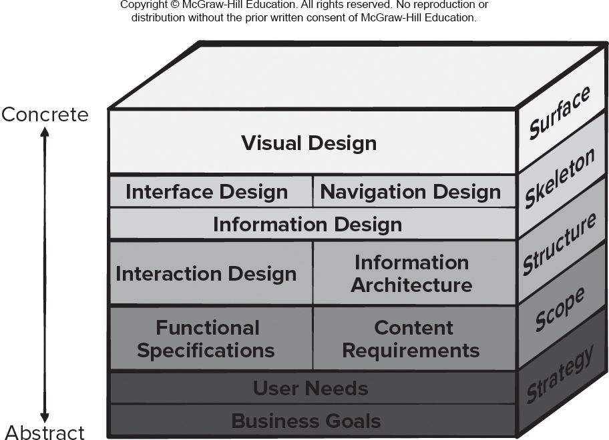
12.1 User Experience Design Elements 1
Access the text alternative for slide images.

Slide 240
12.1.1 Information Architecture
Information architecture structures lead organization, labeling, navigation, and searching of content objects.
Content architecture focuses on the manner content objects are structured for presentation and navigation.
Software architecture addresses the manner the application is structured to manage user interaction, effect navigation, and present content.
Architecture design is conducted in parallel with interface design, aesthetic design, and content design.
Decisions made during architecture design action will influence work conducted during navigation design.

Slide 241
12.1.2 User Interaction Design
Interaction design focuses on interface between product and user.
Modes of user input and output include voice input, computer speech generation, touch input, 3D printed output, immersive augmented reality experiences, and sensor tracking of users.
User interaction should be defined by the stakeholders in the user stories created to describe how users can accomplish their goals using the software product.
User interaction design should also include a plan for how information should be presented within such a system and how to enable the user to understand that information.
It is important to recall that the purpose of the user interface is to present just enough information to help the users decide what their next action should be to accomplish their goal and how to perform it.

Slide 242
12.1.3 Usability Engineering
Usability engineering is part of U X design work that defines the specification, design, and testing of the human-computer interaction portion of a software product.
This software engineering action focuses on devising human-computer interfaces that have high usability.
If developers focus on making a product easy to learn, easy to use, and easy to remember over time, usability can be measured quantitatively and tested for improvements in usability.
Accessibility is the degree to which people with special needs are provided with a means to perceive, understand, navigate, and interact with computer products.
Accessibility is another aspect of usability engineering that needs to be considered during design.

Slide 243
Usability-
A qualitative measure of the ease and efficiency with which a human can employ the functions and features offered by the high-tech product (system)
© 2010 Sichuan University All rights reserved. | Confidential

Slide 244
12.1.4 Visual Design
Visual design (aesthetic design or graphic design) is an artistic endeavor that complements补充 the technical aspects of the user experience design.
Without it, a software product may be functional, but unappealing.
With it, a product draws its users into a world that embraces them on an emotional as well as an intellectual level.
Graphic design considers every aspect of the look and feel of a web or mobile app.
Not every software engineer has artistic talent. If you fall into this category, hire an experienced graphic designer to help.

Slide 245
User Interface Design （definition）
Design of the interface between a human and the computer
Easy to learn?
Easy to use?
Easy to understand?
© 2010 Sichuan University All rights reserved. | Confidential

Slide 246
User Interface Design
Typical Design Errors
lack of consistency
too much memorization
no guidance / help
no context sensitivity
poor response
Arcane/unfriendly
© 2010 Sichuan University All rights reserved. | Confidential

Slide 247
补充
Typical Design Errors
窗口风格不一致
提示说明不一致 （OK，确定…）
不简洁，不容易操作
记忆，取消、重做
提示，帮助，操作指南
系统响应（快慢无所谓，要有进度显示）
友好
。。。
© 2010 Sichuan University All rights reserved. | Confidential

Slide 248
12.2 Golden Rules
Place the user in control
-用户操作控制
Reduce the user’s memory load
-减少用户的记忆负担
Make the interface consistent
-保持界面一致
© 2010 Sichuan University All rights reserved. | Confidential

Slide 249
12.2.1 Place the User in Control-1
Define interaction modes in a way that does not force
a user into unnecessary or undesired actions.
不要引导（强迫）用户进入一些不需操作或不喜欢的地方
例：网络的弹出广告…
Provide for flexible interaction.
提供灵活的交互
Allow user interaction to be interruptible and undoable.
允许用户中断、取消交互操作
Streamline interaction as skill levels advance and allow
the interaction to be customized.
用户自定义交互和角色
© 2010 Sichuan University All rights reserved. | Confidential

Slide 250
12.2.1 Place the User in Control-2
Hide technical internals from the casual user.
用户不必关心系统实现技术细节
Design for direct interaction with objects that appear
on the screen.
提供用户直观甚至身临其境的感觉
（例：3D显示-google街景视图；声音、动感-飞行模拟器；游戏…）
© 2010 Sichuan University All rights reserved. | Confidential

Slide 251
12.2.2 Reduce the User’s Memory Load
Reduce demand on short-term memory.
减少短期记忆（尤其是短期，大量重复的动作，系统能够提供快捷的操作提示、默认、批处理等等）
Establish meaningful defaults.
建立默认、缺省设置
Define shortcuts that are intuitive.
定义直观的快捷方式
The visual layout of the interface should be based on a real world metaphor.
直观、可视化的布局
Disclose information in a progressive fashion.
分层次、渐进的显示信息
© 2010 Sichuan University All rights reserved. | Confidential

Slide 252
12.2.3 Make the Interface Consistent
The interface should present and acquire information in a consistent fashion
Allow the user to put the current task into a meaningful context.
操作在很友好的环境中进行（例如：操作提示前一步，后一步）
Maintain consistency across a family of applications.
一组应用的一致性 （copy，paste， cut…）
If past interactive models have created user expectations, do not make changes unless there is a compelling reason to do so.
使用习惯的一致性(与过去的系统使用习惯一致)
© 2010 Sichuan University All rights reserved. | Confidential

Slide 253
12.3 User Interface Analysis and Design
© 2010 Sichuan University All rights reserved. | Confidential

Slide 254
12.3.1 User Interface Design Models
Four different models come into play when a user interface is to be analyzed and designed
User model — 用户模型
Design model — 设计模型
Mental model (system perception) —用户的心理模型(系统感知)
Implementation model — 实现模型
上述4种模型可能相距甚远，尤其是用户的想象与设计人员的理解与实现，可能相距较远。界面设计的任务就是消除这些差距，导出一致的界面
当系统实现模型与用户心理模型相一致时，就是一个理想的界面设计
© 2010 Sichuan University All rights reserved. | Confidential

Slide 255
12.3.1 User Interface Design Models（同前）
User model (SE设计开发人员建立用户模型，了解用户并分类)
a profile of all end users of the system
Design model (SE设计开发人员建立设计模型)
a design realization of the user model
Mental model (system perception) (最终用户在脑海里对系统的想象)
the user’s mental image of what the interface is;
is the image of system that users carry in their heads.
Implementation model (implementer建立实现模型，就是真实系统的展现)
the interface “look and feel” coupled with supporting information that describe interface syntax and semantics
© 2010 Sichuan University All rights reserved. | Confidential

Slide 256
Understanding user & Tasks
Understanding user
Novices 新手
Knowledgeable, intermittent users 间歇的用户
Knowledgeable, frequent users 频繁的用户
The most important principle of user interface design:
Know the user, know the tasks
© 2010 Sichuan University All rights reserved. | Confidential

Slide 257
The most important principle of user interface design:
Know the user, know the tasks
了解用户，了解任务
© 2010 Sichuan University All rights reserved. | Confidential

Slide 258
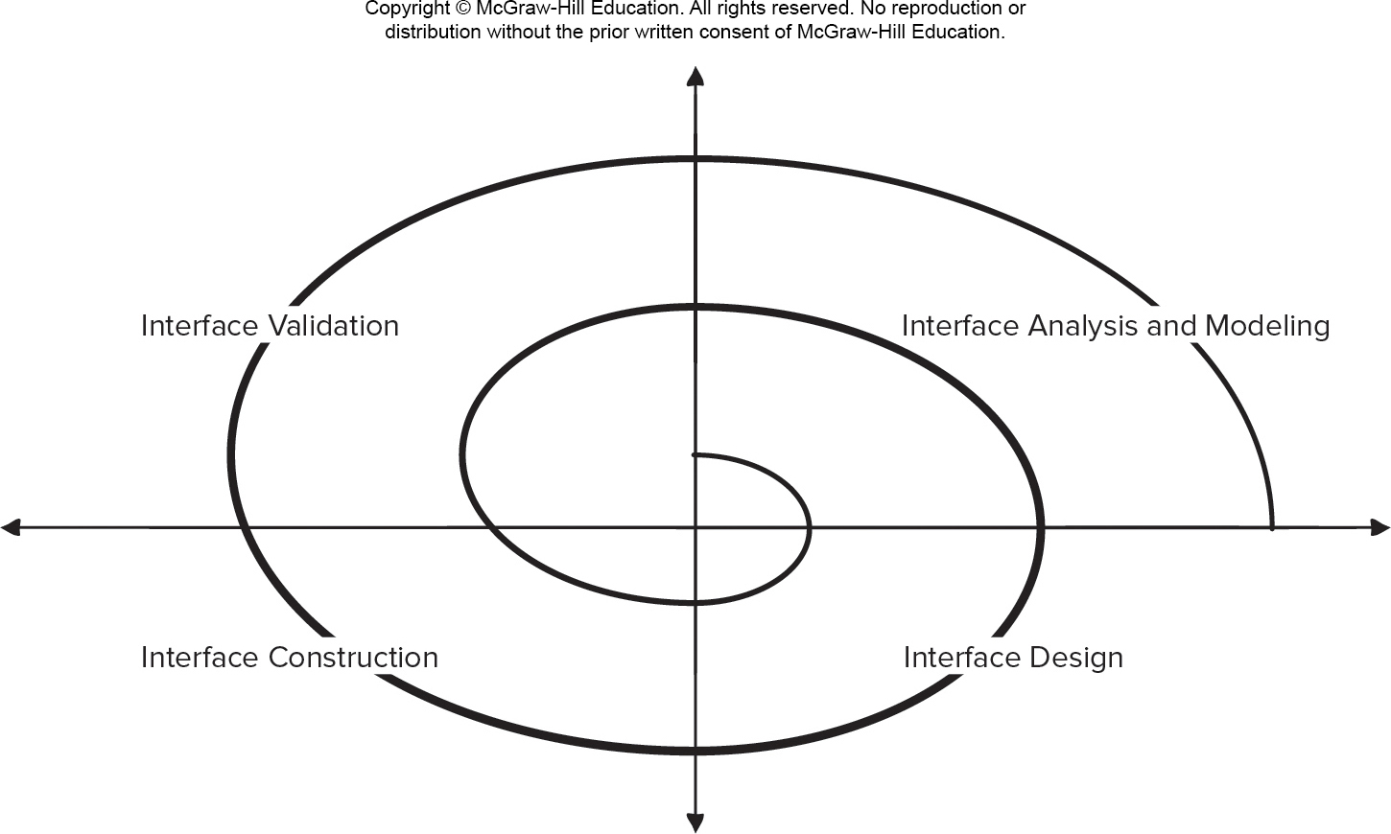
12.3.2 User Interface Design Process
Framework activities:分析（建模）-设计-实现-确认
Interface analysis and modeling
Interface design
Interface construction
Interface validation
© 2010 Sichuan University All rights reserved. | Confidential

Slide 259
User Interface Design Process
Interface analysis focuses on the profile of the users who will interact with the system.
Interface design defines a set of interface objects and actions that enable a user to perform all defined tasks in a manner that meets every usability goal defined for the system.
Interface construction normally begins with the creation of a prototype that enables usage scenarios to be evaluated.
Interface validation focuses on:
The ability of the interface to implement every user task correctly.
The degree to which interface is easy to use and easy to learn.
The user’s acceptance of the interface as a tool in her work.

Slide 260
1/4 Interface analysis and modeling
用户分析和任务分析与建模：
界面分析重点在于那些与系统交互的用户，定义不同用户的类型，了解用户；（了解用户）
其次是任务分析，标识、描述和细化用户为达到系统目标而执行的操作和任务（了解任务）
接下来在12.3 节中详细描述
© 2010 Sichuan University All rights reserved. | Confidential

Slide 261
2/4 Interface design
设计目标：
Define a set of interface objects and actions (and their screen representations) that enable a user to perform all defined tasks in a manner that meets every usability goal defined for the system
接下来在12.4 节中详细描述
© 2010 Sichuan University All rights reserved. | Confidential

Slide 262
3/4 Interface construction
界面构建，实现一个用户界面（开始可以是一个原型，逐步迭代求精）
© 2010 Sichuan University All rights reserved. | Confidential

Slide 263
4/4 Interface validation
the ability of the interface to implement every user task correctly to accommodate all task variations, and to achieve all general user requirements
The degree to which the interface is easy to use and easy to learn
The use’s acceptance of the interface as a useful tool in their work
© 2010 Sichuan University All rights reserved. | Confidential

Slide 264
12.4 Interface Analysis
用户、任务、显示内容、工作环境分析
Interface analysis means understanding
the people (end-users) who will interact with the system through the interface;
the tasks that end-users must perform to do their work,
the content that is presented as part of the interface
尤其是WEB应用，音视频、文本、动画…
the environment in which these tasks will be conducted.
尤其是一些特殊环境，恶劣环境，太空，下载空间…
© 2010 Sichuan University All rights reserved. | Confidential

Slide 265
12.4.1 User Research
Christensen suggests the following steps to create a customer journey map:
Gather stakeholders.
Conduct research. Collect all information you can about all the things users may experience as they use the software product and define your customer phases (touchpoints).
Build the model. Create a visualization of the touch points.
Refine the design. Recruit招募 a designer to make the deliverable visually appealing and ensure touchpoints are identified clearly.
Identify gaps. Note any gaps in the customer experience or points of friction or pain (poor transition between phases).
Implement your findings. Assign responsible parties to bridge the gaps and resolve pain points found.

Slide 266
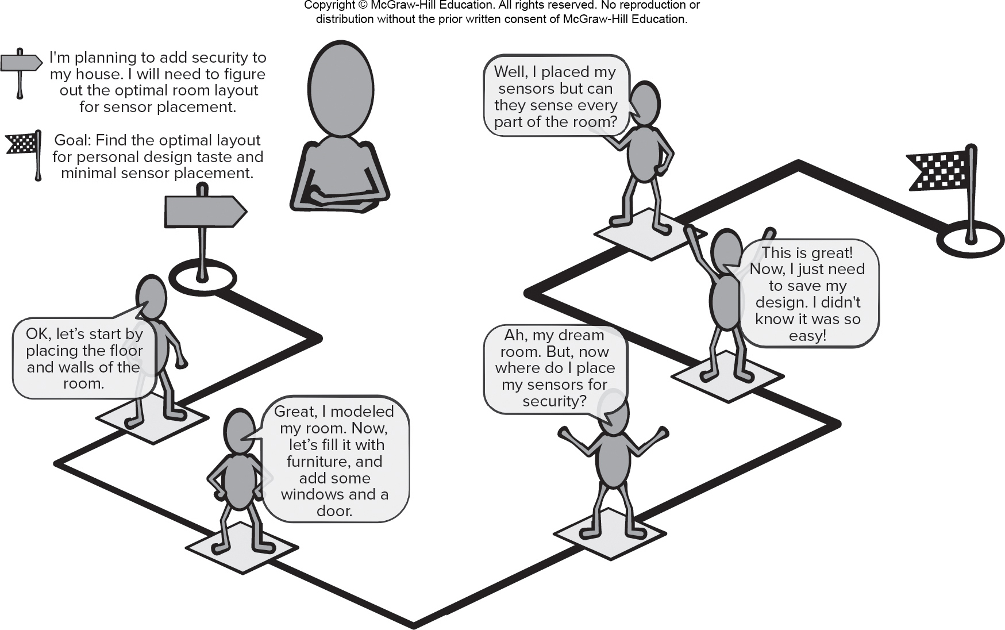
Customer Journey Map
Access the text alternative for slide images.

Slide 267
12.4.2 User Modeling
Creating and Using Personas（four tasks）：
Data collection and analysis. Stakeholders collect information about proposed product users and determine the user group needs.
Describe personas. The developers need to decide how many personas to create and decide which persona will be their focus.
Develop scenarios. Scenarios are user stories about how personas will use the product being developed. They may focus on the touchpoints and obstacles described in the customer journey.
Acceptance by stakeholders. Often this is done by validating the scenarios using a review technique or demonstration called cognitive walkthrough (stakeholders assume the role defined by a persona and work through a scenario using a system prototype).

Slide 268
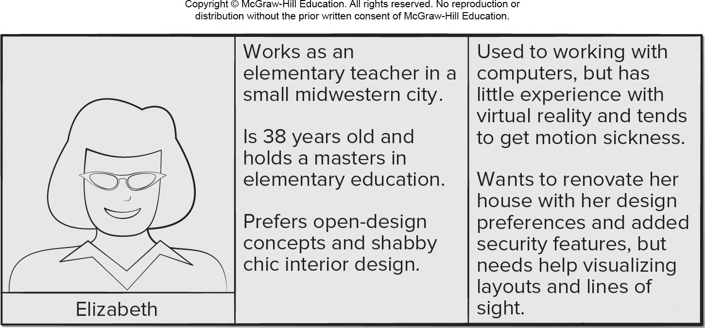
Persona Example
Access the text alternative for slide images.

Slide 269
12.4.2 User Analysis
The only way that you can get the user’s mental image and the design model to converge 汇集 is to work to understand the users,
User interviews
Sales input
Marketing input
Support input
老人、小孩的用户体验；
市场调查
例：老年手机
© 2010 Sichuan University All rights reserved. | Confidential

Slide 270
12.4.2 User Analysis
下面一组问题，帮助了解用户： （包括用户背景-教育-家庭-性别-工作-使用频率-报酬-…）
Are users trained professionals, technician, clerical, or manufacturing workers?
What level of formal education does the average user have?
Are the users capable of learning from written materials or have they expressed a desire for classroom training?
Are users expert typists or keyboard phobic恐惧?
What is the age range of the user community?
Will the users be represented predominately by one gender?
How are users compensated for the work they perform?报酬
Do users work normal office hours or do they work until the job is done?
Is the software to be an integral part of the work users do or will it be used only occasionally?
What is the primary spoken language among users?
What are the consequences if a user makes a mistake using the system?
Are users experts in the subject matter that is addressed by the system?
Do users want to know about the technology the sits behind the interface?
© 2010 Sichuan University All rights reserved. | Confidential

Slide 271
12.4.3 Task Analysis and Modeling
Answers the following questions …(完成什么工作，流程，任务层次…)
What work will the user perform in specific circumstances?
What tasks and subtasks will be performed as the user does the work?
What specific problem domain objects will the user manipulate as work is performed?
What is the sequence of work tasks—the workflow?
What is the hierarchy of tasks?
© 2010 Sichuan University All rights reserved. | Confidential

Slide 272
12.4.3 Task Analysis and Modeling
Use-cases
define basic interaction
Task elaboration
refines interactive tasks.
Task analysis: 1-Understand the tasks that people currently perform (when use a manual approach)
Task analysis: 2-study an existing specification for a computer-based solution and derive a set of user tasks that will accommodate the user model, the design model…
Object elaboration （相当于用户接口类的设计与细化）
identifies interface objects (classes)
Workflow analysis
defines how a work process is completed when several people (and roles) are involved (UML swimlane)
Hierarchical representation (层次表示)
A task hierarchy can be defined for each user type. The hierarchy is derived by stepwise elaboration of each task.
© 2010 Sichuan University All rights reserved. | Confidential

Slide 273
Workflow analysis
注：用户不同，权限不同，界面和操作不同，所访问的数据和获取的信息等都不相同
同样，看后页泳道图（病人patient、药剂师pharmacist、医生physician）
对病人取药药方prescription的处理流程、内容不同
© 2010 Sichuan University All rights reserved. | Confidential

Slide 274
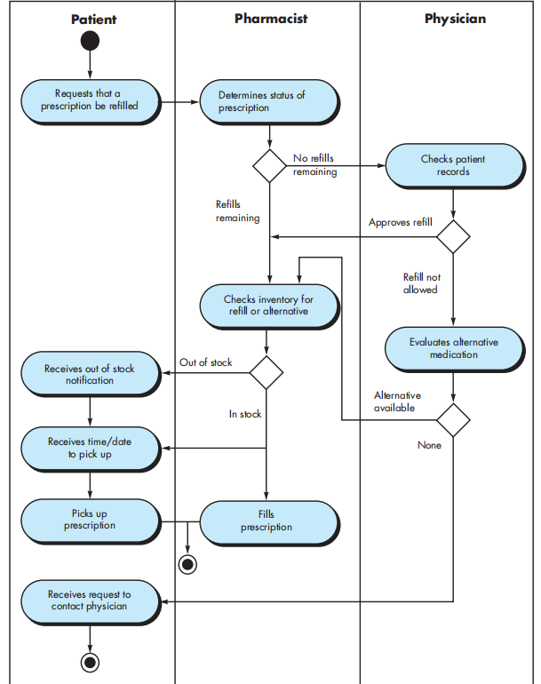
Swimlane Diagram
Figure 12.2
prescription refill function
© 2010 Sichuan University All rights reserved. | Confidential

Slide 275
Analysis of Display Content显示内容
数据可视化
文字、表格、图形、音频、视频等
输出数据来源
本系统
数据库
系统外部输入
© 2010 Sichuan University All rights reserved. | Confidential

Slide 276
Analysis of Display Content显示内容
The format and aesthetics 美观 of the content should be considered by the designer
Are different types of data assigned to consistent geographic locations on the screen (e.g., photos always appear in the upper right hand corner)?界面风格一致性
Can the user customize the screen location for content?自定义界面
Is proper on-screen identification assigned to all content? （如：图标）
If a large report is to be presented, how should it be partitioned for ease of understanding?
Will mechanisms be available for moving directly to summary information for large collections of data.
Will graphical output be scaled to fit within the bounds of the display device that is used?显示范围自适应
How will color to be used to enhance understanding?
How will error messages and warning be presented to the user?
© 2010 Sichuan University All rights reserved. | Confidential

Slide 277
12.4.4 Analysis of the work environment
Users do not perform their work in isolation, they are influenced by the activity around them：
The physical characteristic of the workplace (e.g. user-friendly location, 人机工学-座位、亮度、工作台尺寸、布局、输入设备等;
sometimes the design is constrained by the factors that mitigate against ease of use, e.g. space station)
有时，设计会受到某些因素的约束和限制,这些因素会减弱易用性（如：空间站，机舱等）
The workplace culture
© 2010 Sichuan University All rights reserved. | Confidential

Slide 278
12.4 界面分析（上节）
12.5 12.6 界面设计（下节）
© 2010 Sichuan University All rights reserved. | Confidential

Slide 279
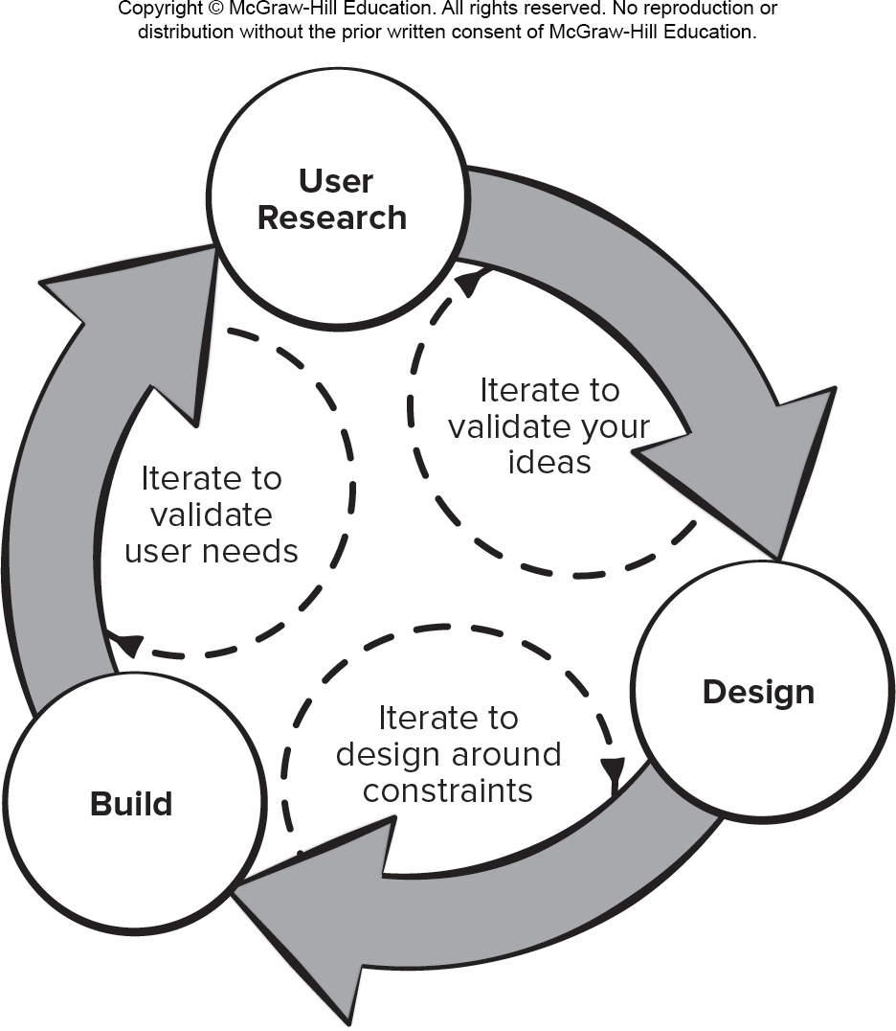
12.5 User Experience Design(UX Design)
Iterative UX Design Process:
Access the text alternative for slide images.

Slide 280
Google 5-Day U X Design Sprint 1
Understand. User research activities (user needs and business goals) for the software product. This information is posted on whiteboards (For example, customer journey maps, personas, user task workflow) for easy reference throughout the sprint.
Sketch初稿素描. Individual stakeholders are given the time and space needed to brainstorm solutions to the problems discovered in the understand phase. Paper drawings and notes are easy to generate, easy to modify, and quite inexpensive.
Decide. Each stakeholder presents his solution sketch and the team votes to determine the solutions that should be tackled in the prototyping activities that will follow. If there is not a clear consensus following the voting, the development team may decide to consider assumptions that involve project constraints and resources.

Slide 281
Google 5-Day U X Design Sprint 2
Prototype. May be a minimally viable product based on the solution selected from the sketch phase, or it may be based on the portions of the customer journey map or storyboard you want to evaluate with potential users in the validate phase. This means the team should be developing test cases based on the user stories as the prototype is being built.
Validate. Every developer watching users try out the prototype this is the best way to discover major issues with its U X design, which in turn lets you start iterating immediately. This is critical to capturing potential learning opportunities by exposing product decision makers to user feedback in real time.

Slide 282
12.6.1 Interface Design Steps
界面设计同样是一个迭代过程，建议步骤：
Using information developed during interface analysis, define interface objects and actions (operations).使用界面分析中获得的信息，定义界面对象和操作
Define events (user actions) that will cause the state of the user interface to change. Model this behavior.定义那些导致用户界面状态发生变化的事件（用户动作），并对行为建模
Depict each interface state as it will actually look to the end-user.描述每个界面状态（比如菜单项、窗口等，用户实际看到的样子）
Indicate how the user interprets the state of the system from information provided through the interface.指出用户如何从界面提供的界面信息来解释系统状态？？
© 2010 Sichuan University All rights reserved. | Confidential

Slide 283
12.6.1 Interface Design Steps-续
不管设计任务的顺序如何，设计师应：
Always follow the golden rules
Model how the interface will be implemented
Consider the environment that will be used
简而言之：
设计每个菜单、各种窗口（信息展示窗口、相应窗口）、操作（按钮）、帮助
© 2010 Sichuan University All rights reserved. | Confidential

Slide 284
SafeHome 设计举例 - the Figure 12.3
界面设计的一个重要步骤是定义界面对象和作用于对象上的操作…
The interface objects and actions are defined from use scenarios, use-cases
The interface objects and actions are elaborated iteratively (include source object, target object application object )
Screen layout is performed-界面布局
To provide a brief illustration of the design steps, See the example SafeHome and the Figure 12.3 preliminary screen layout
© 2010 Sichuan University All rights reserved. | Confidential

Slide 285
12.6.2 Interface Design Patterns
界面风格设计无时不用模版（win, android, apple os），鼠标，滚动条，下拉菜单，弹出窗口，状态栏，图标，进度条，树形列表，触摸操作,日期和时间显示,登录用户提示
Patterns are available for
The complete UI
Page layout
Forms and input
Tables
Direct data manipulation
Navigation
Searching
Page elements
e-Commerce
© 2010 Sichuan University All rights reserved. | Confidential

Slide 286
Interface Design Patterns- Example：
日期（日历）显示与输入
用户登录
…
© 2010 Sichuan University All rights reserved. | Confidential

Slide 287
Design Issues
Response time
Help facilities
Error handling
Menu and command labeling (菜单与命令标记，用菜单、ToolBar、按钮，而不是命令行执行操作…)
Application accessibility 可访问性（例如：使用键盘、触屏、语音、手势等，网络，蓝牙，GPS，身体残障人员等）微信
Internationalization （语言，公制/英制；道路规则，Unicode统一码）
© 2010 Sichuan University All rights reserved. | Confidential

Slide 288
日本瑞穗证券公司错误交易指令事件
2005 年12 月8 日是J-COM 公司在东京证券交易所创业板上市首日
瑞穗证券公司大宗交易部的一名交易员将“以610,000 日元的价格出售1 股J-COM 股票”误输入为“以1 日元价格出售610,000 股J-COM 公司股票”
瑞穗证券公司相关工作人员疏忽，虽然电脑操作屏上的市场价格栏中出现了输入有误的警告,该操盘手便忽略警告，继续操作。
东京证券交易所系统存在缺陷且未能及时采取措施。例：按照交易所系统的处理逻辑，如果某笔限价委托的价格超过当日最高或最低限价，系统便自动将其委托价格修正为最高或最低限价（默认处理）。当限价委托指令一旦进入“默认处理”状态，且同时有符合条件的反向委托指令存在时，该委托指令便不能被撤销，这就是导致瑞穗证券公司四次撤单失败的关键原因。
瑞穗证券公司表示，在其向交易所主机发出撤单申请时，该笔卖单只成交了不足2,000 股。如果其撤单指令能够及时执行或暂停，损失的金额约为6亿日元，而事实上这一损失却达到了400 亿日元之巨。
机构投资者“趁火打劫”。有些券商自觉停止买入该股票，如德意志证券等。但更多的券商却是趁机在跌停价附近以自营盘抢购该股票，以UBS 为最，该公司持续买入直至收盘，共买入38,198 股，获利120 亿日元。其他买入该股票较多券商的有摩根士坦利等5家。这6 家券商从此次事件中获利共计168 亿日元，占瑞穗证券公司的此次损失的42%。
东京证券交易所总经理引咎辞职
交易所会同交易系统的开发商富士通公司系统设计缺陷
© 2010 Sichuan University All rights reserved. | Confidential

Slide 289
Aesthetic Design 美观设计
Don’t be afraid of white space.
Emphasize content.
Organize layout elements from top-left to bottom right.
Group navigation, content, and function geographically within the page.
Don’t extend your real estate with the scrolling bar.
Consider resolution and browser window size when designing layout.
建议，找一个平面设计师进行设计，跳出软件工程师很多固定思维模式 Thinking Out of Box
设计就是灵感（如：鼠标），同时看得多、用得多，对设计也有很好的借鉴和帮助
© 2010 Sichuan University All rights reserved. | Confidential

Slide 290
12.7 Design Evaluation
可以在建立原型之前就对用户界面的质量进行评估，能及早发现问题，可以减少评估循环次数，从而缩短开发时间
Evaluate the quality of a user interface before a prototype is built.
The length and complexity of the requirement model (or requirement specification) – indicate the learning effort required by user 反映用户学习掌握系统的难度
The number of user tasks specified and the average number of actions per task-indicate the interaction time & efficiency of the system 反映系统交互时间和效率
The number of actions, tasks, and system states – indicate the memory load of the user 反映用户学习系统所要记忆的内容
Interface style, help facilities, and error handling protocol – indicate the complexity of the interface and the degree to which it will be accepted by the user 反映界面复杂度和用户接受程度
© 2010 Sichuan University All rights reserved. | Confidential

Slide 291
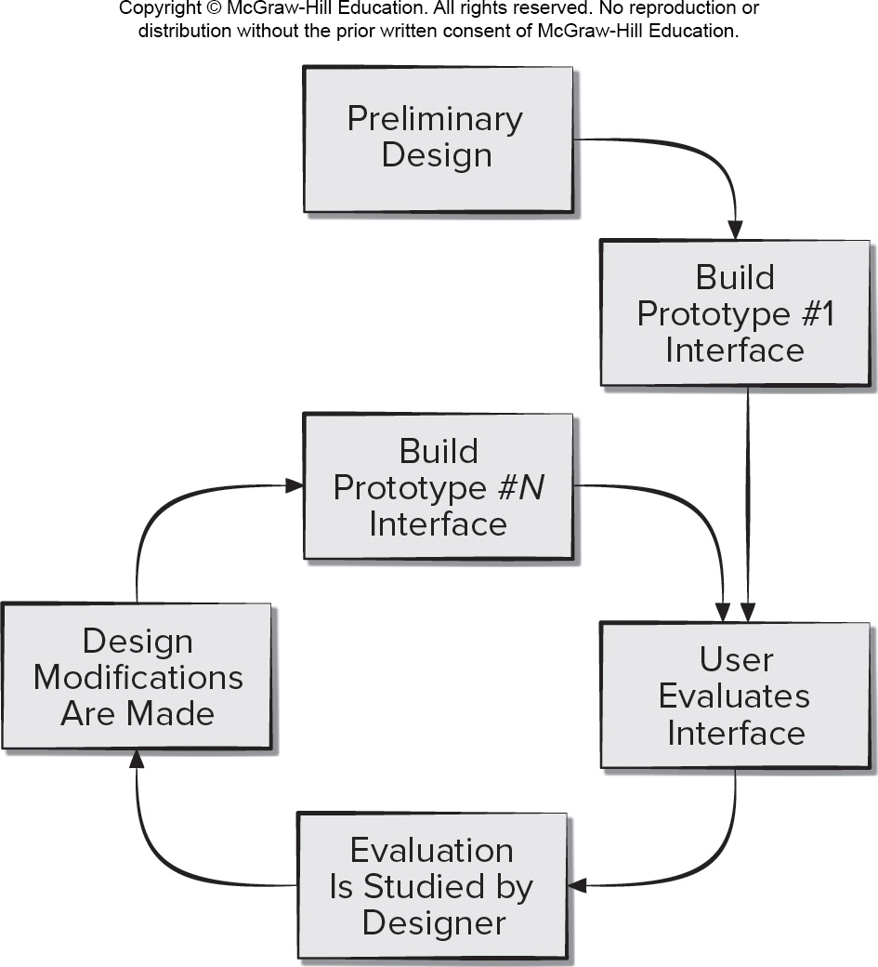
12.7 Interface Design Evaluation Cycle
Access the text alternative for slide images.

Slide 292
12.8.1 Usability Guidelines 1
Anticipation. An application should be designed so that it anticipates the user’s next move.
Communication. The interface should communicate the status of any activity initiated by the user.
Consistency. The use of navigation controls, menus, icons, and aesthetics (For example, color, shape, layout) should be consistent throughout.
Controlled Autonomy. The interface should facilitate user movement throughout the application, but it should do so in a manner that enforces navigation conventions that have been established for the application.
Efficiency. The design of the application and its interface should optimize the user’s work efficiency.

Slide 293
12.8.1 Usability Guidelines 2
Flexibility. The interface should be flexible enough to enable some users to accomplish tasks directly and others to explore the application in a somewhat random fashion.
Focus. The interface (and the content it presents) should stay focused on the user task(s) at hand.
Human Interface Objects. A vast library of reusable human interface objects has been developed for both Web and mobile apps. Use them.
Latency Reduction. Rather than making the user wait for some internal operation to complete (for example, downloading a complex graphical image), the application should use multitasking in a way that lets the user proceed with work as if the operation has been completed.

Slide 294
12.8.1 Usability Guidelines 3
Learnability. An application interface should be designed to minimize learning time and, once learned, to minimize relearning required when the app is revisited.
Metaphors. An interface that uses an interaction metaphor is easier to learn and easier to use, as long as the metaphor is appropriate for the application and the user.
Readability. All information presented through the interface should be readable by young and old.
Track State. When appropriate, the state of the user interaction should be tracked and stored so that a user can log off and return later to pick up where he left off.
Visible Navigation. A well-designed interface provides the illusion that users are in the same place, with the work brought to them.

Slide 295
12.8.2 Accessibilty Guidelines 1
Application Accessibility. Software engineers must ensure that interface design encompasses mechanisms that enable easy for people with special needs.
Response Time. System response time has two important characteristics: length and variability. Aim for consistency to avoid user frustration.
Help Facilities. Modern software should provide online help facilities that enable a user to get a question answered or resolve a problem without leaving the interface.
Error Handling. Every error message or warning produced by an interactive system should: use user understandable jargon, provide constructive error recovery advice, identify negative consequences of errors, contain an audible or visual cue, and never blame user for causing the error.

Slide 296
12.8.2 Accessibilty Guidelines 2
Menu and Command Labeling. The use of window-oriented, point-and-pick interfaces has reduced reliance on typed commands. How every it is important to: ensure every menu option has a command version, make commands easy for users to type, make commands easy to remember, allow for command abbreviation, make sure menu labels are self-explanatory, make sure submenus match style of master menu items, and ensure command conventions work across the family of applications.
Internationalization. Software engineers and their managers invariably underestimate the effort and skills required to create user interfaces that accommodate the needs of different locales and languages.

Slide 297
GUI 设计举例：

Slide 298
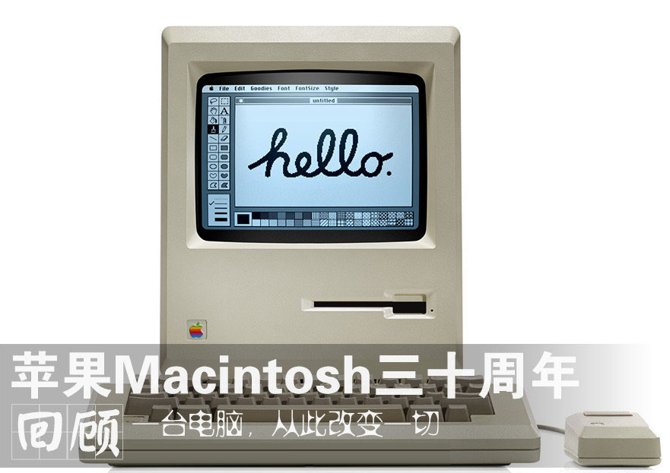
APPLE

Slide 299
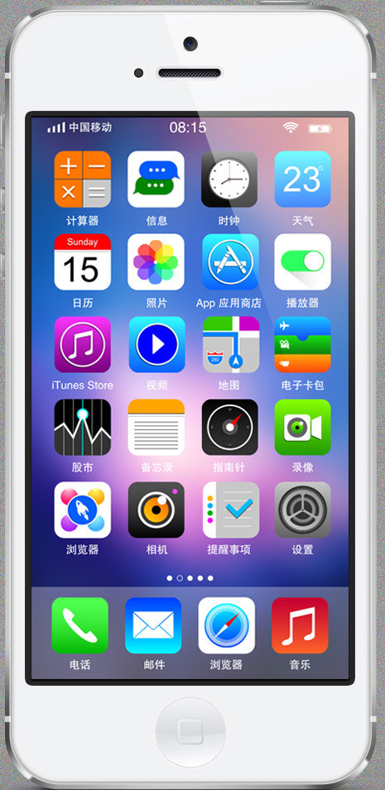
SMARTPHONE

Slide 300
航班查询、订票
起飞机场、落地机场、日期
单程-往返选择、数量（成人，儿童）
仓位
票价
进一步：
起飞落地机场可选（可输入中文，或代码）
日期（日期选择，包括年、月翻动，日期选择）
数量（成人，儿童）、仓位等选择

Slide 301
航班查询、订票
默认：
起飞落地机场可选，退出时可选择保存，设为默认
日期（起飞日期默认当天，返程日期。默认周以后，可配置）
票价默认为选定日所有航班票价（可选+- 3days或7days）
记忆：
常旅客信息记录
输入内容记录（即便是暂存）！

Slide 302
航班查询、订票
更好的设计：
多航段
票价月历
国际化：显示语言，支持货币转换显示

Slide 303
选票系统
重点考虑用户对象，尤其是disabilities，education level
简单、易识别（文字和图像）
一张选票还是几张选票
正当选票还是个人选票
公投议题

Slide 304
使用简易拨盘，实现（中英文）文字输入
资源：
原形拨盘（拨盘可以按下、旋转）
有两个按钮（“确定”，“返回”）
GUI设计：
系统初始界面：多个按钮，其中一个为查询功能，可以移动拨盘，到查询按钮，按下拨盘选中此功能。
弹出输入界面（同任何平板电脑或手机输入界面），选择英文字母（拼音）进行中英文输入（可以旋转原形拨盘选择相应的字母，按下拨盘选中）
输入完成后，选择“确定”按钮进行查询，选择“返回”按钮返回主菜单

Slide 305
Summary
The gold rules:
1. place the user in control;
2.reduce the use’s memory load;
3.make the interface consistent
© 2010 Sichuan University All rights reserved. | Confidential

Slide 306
Summary
User Interface Design Process
Interface analysis and modeling
Interface design
Interface construction
Interface validation

Slide 307
Summary
Interface Analysis
The development of a user interface begins with a series of analysis tasks: user analysis; task analysis; display content analysis; environmental analysis
the people (end-users) who will interact with the system through the interface;
the tasks that end-users must perform to do their work,
the content that is presented as part of the interface
the environment in which these tasks will be conducted.
© 2010 Sichuan University All rights reserved. | Confidential

Slide 308
Summary（同前页，参考）
The development of a user interface begins with a series of analysis tasks.
User analysis defines personas for the profiles of various end users and is gathered from a variety of business and technical sources. The user analysis allows the developers to create a customer journey map as a visual representation of the goals for the product. Task analysis defines user tasks and actions using either an elaborative or object-oriented approach, applying use cases, task and object elaboration, workflow analysis, and hierarchical task representations to fully understand the human-computer interaction. Environmental analysis identifies the physical and social structures in which the interface must operate.
© 2010 Sichuan University All rights reserved. | Confidential

Slide 309
Summary
Interface design ：
user scenarios are created and analyzed to define a set of interface objects and actions;
depict each interface state (e.g. screen layout); …
design issues such as response times, command and action structure, error handling, and help facilities are considered as the design model is refined.
© 2010 Sichuan University All rights reserved. | Confidential

Slide 310
Summary
The user interface is the window into the software. The interface molds a user’s perception感觉 of the quality of the system
© 2010 Sichuan University All rights reserved. | Confidential

Slide 311
Answer: 1-d 2-d
Exercise
Which of the following interface design principles does not allow the user to remain in control of the interaction with a computer?
allow interaction to interruptible
allow interaction to be undoable
hide technical internals from casual users
only provide one defined method for accomplishing a task
Which one of the following interface design principles does Not reduce the user's memory load?
define intuitive shortcuts
disclose information in a progressive fashion
establish meaningful defaults
provide an on-line tutorial
© 2010 Sichuan University All rights reserved. | Confidential

Slide 312
Answer: 3-e 4-b
Exercise
3.Interface consistency implies that
each application should have its own distinctive look and feel
input mechanisms remain the same throughout the application
navigational methods are context sensitive
visual information is organized according to a design standard
both b and d
4.The reason for reducing the user‘s memory load is make his or her interaction with the computer quicker to complete.
True
False
© 2010 Sichuan University All rights reserved. | Confidential

Slide 313
Answer: 5-c 6-a
Exercise
5. Which model depicts the profile of the end users of a computer system?
design model
implementation model
user model
user's model
6. Which of these framework activities is not normally associated with the user interface design processes?
cost estimation
interface construction
interface validation
user and task analysis
© 2010 Sichuan University All rights reserved. | Confidential

Slide 314
Answer: 7-e 8-e
Exercise
7. Which approach(es) to user task analysis can be useful in user interface design?
have users indicate their preferences on questionnaires
rely on the judgement of experienced programmers
study existing computer-based solutions
observe users performing tasks manually
both c and d
8. Several usability measures can be collected while observing users interacting with a computer system including ？？
a. down time for the application
b. number of user errors
c. software reliability
d. time spent looking at help materials
e. both b and d
© 2010 Sichuan University All rights reserved. | Confidential

Slide 315
Answer: 9-a 10-d
Exercise
9.It is sometimes possible that the interface designer is constrained by environmental factors that mitigate against ease of use for many users.
a. True
b. False
10. Which model depicts the image of a system that an end user creates in his or her head?
a. design model
b. user model
c. system model
d. system perception
© 2010 Sichuan University All rights reserved. | Confidential

Slide 316
Answer: 11-a 12-e
Exercise
11.If past interactive models have created certain user expectations it is not generally good to make changes to the model.
a. True b. False
12. Several common design issues surface for almost every user interface including
a. adaptive user profiles b. error handling resolution of graphics
c. displays system d. response time
e. both b and d
© 2010 Sichuan University All rights reserved. | Confidential

Slide 317
homework （2023-10-26）
1. List three principles that should be applied when building any user interface.
2.What framework activities are completed when following an evolutionary (or spiral) user interface development process?
3.List four things you need to do in user experience analysis.
4.What elements of a user interface design can be evaluated before a prototype is built?
5. List four interface design issues present in the development of most user interfaces.
© 2010 Sichuan University All rights reserved. | Confidential

